Slide 1
Measles and Rubella
Global Update
January 2025

Slide 2
Distribution list
This report is posted on the WHO Immunization data portal (https://immunizationdata.who.int/global?topic=Provisional-measles-and-rubella-data&location=) and distributed by email on a monthly basis.
To join the distribution list, please send an email to Sebastien Antoni (antonis@who.int)

Slide 3
Disclaimer
Please note that all data contained within is provisional. The number of cases of measles and rubella officially reported by a member state is only available by July of each year (through the joint WHO UNICEF annual data collection exercise). If any numbers from this provisional data are quoted, they should be properly sourced with a date (i.e. "provisional data based on monthly data reported to WHO (Geneva) as of January 2025"). For official data from 1980-2023, please visit our website.

Slide 4
Data sources and limitations

Slide 5
Measles

Slide 6
Number of reported measles cases by WHO Region
2024
Region | Member States* | Suspected cases | Measles cases | Clin | Epi | Lab | Date Received
AFR | 43/47 | 118,210 | 80,769 | 10,942 | 53,616 | 16,211 | 2024-12
AMR | 33/35 | 17,157 | 455 | 0 | 53 | 402 | 2025-01
EMR | 20/21 | 140,419 | 90,007 | 51,305 | 5,018 | 33,684 | 2025-01
EUR | 51/53 | 126,268 | 106,237 | 20,797 | 14,129 | 71,311 | 2025-01
SEAR | 11/11 | 134,153 | 32,838 | 11,996 | 6,111 | 14,731 | 2024-12
WPR | 25/27 | 59,048 | 10,484 | 4,141 | 304 | 6,039 | 2025-01
Total | 183/194 | 595,255 | 320,790 | 99,181 | 79,231 | 142,378
Region | Jan | Feb | Mar | Apr | May | Jun | Jul | Aug | Sep | Oct | Nov | Dec
AFR | 13,503 | 15,712 | 18,995 | 11,443 | 7,434 | 4,343 | 2,898 | 2,202 | 2,277 | 1,575 | 387 | 0
AMR | 23 | 49 | 103 | 47 | 18 | 19 | 41 | 38 | 37 | 33 | 44 | 3
EMR | 13,017 | 15,097 | 15,745 | 11,223 | 11,362 | 7,459 | 5,241 | 3,537 | 3,244 | 2,384 | 1,018 | 680
EUR | 26,945 | 22,212 | 17,840 | 13,366 | 10,000 | 7,209 | 3,555 | 1,981 | 1,006 | 849 | 1,080 | 194
SEAR | 3,912 | 3,808 | 4,636 | 3,355 | 2,635 | 1,642 | 2,121 | 2,500 | 3,060 | 3,460 | 1,709 | 0
WPR | 925 | 923 | 1,125 | 1,182 | 932 | 678 | 825 | 787 | 790 | 864 | 1,058 | 395
Total | 58,325 | 57,801 | 58,444 | 40,616 | 32,381 | 21,350 | 14,681 | 11,045 | 10,414 | 9,165 | 5,296 | 1,272
2023
Region | Member States* | Suspected cases | Measles cases | Clin | Epi | Lab | Date Received
AFR | 44/47 | 121,250 | 73,443 | 9,243 | 42,099 | 22,101 | 2024-12
AMR | 31/35 | 15,555 | 73 | 0 | 0 | 73 | 2025-01
EMR | 21/21 | 141,072 | 90,855 | 50,838 | 10,635 | 29,382 | 2025-01
EUR | 44/53 | 84,834 | 60,943 | 9,542 | 10,061 | 41,340 | 2025-01
SEAR | 11/11 | 203,317 | 90,832 | 18,945 | 24,234 | 47,653 | 2024-12
WPR | 25/27 | 57,382 | 5,742 | 2,493 | 187 | 3,062 | 2025-01
Total | 176/194 | 623,410 | 321,888 | 91,061 | 87,216 | 143,611
Region | Jan | Feb | Mar | Apr | May | Jun | Jul | Aug | Sep | Oct | Nov | Dec
AFR | 7,262 | 8,589 | 10,589 | 9,022 | 8,903 | 5,849 | 4,329 | 5,134 | 4,884 | 4,599 | 2,768 | 1,515
AMR | 3 | 3 | 4 | 6 | 5 | 4 | 2 | 4 | 10 | 9 | 4 | 19
EMR | 6,222 | 7,847 | 9,098 | 6,991 | 10,358 | 9,018 | 9,116 | 7,184 | 6,564 | 5,704 | 6,082 | 6,671
EUR | 541 | 1,017 | 1,584 | 2,070 | 3,365 | 4,143 | 4,139 | 4,115 | 5,739 | 8,338 | 8,191 | 17,701
SEAR | 16,794 | 14,248 | 15,224 | 11,344 | 8,258 | 5,001 | 3,697 | 4,238 | 3,180 | 2,785 | 3,381 | 2,682
WPR | 97 | 195 | 224 | 293 | 354 | 335 | 407 | 497 | 776 | 909 | 915 | 740
Total | 30,919 | 31,899 | 36,723 | 29,726 | 31,243 | 24,350 | 21,690 | 21,172 | 21,153 | 22,344 | 21,341 | 29,328
Notes: Based on data received 2025-01 - This is surveillance data, hence for the last month, the data may be incomplete. * Member States Reporting / Total Member States in Region

Slide 7

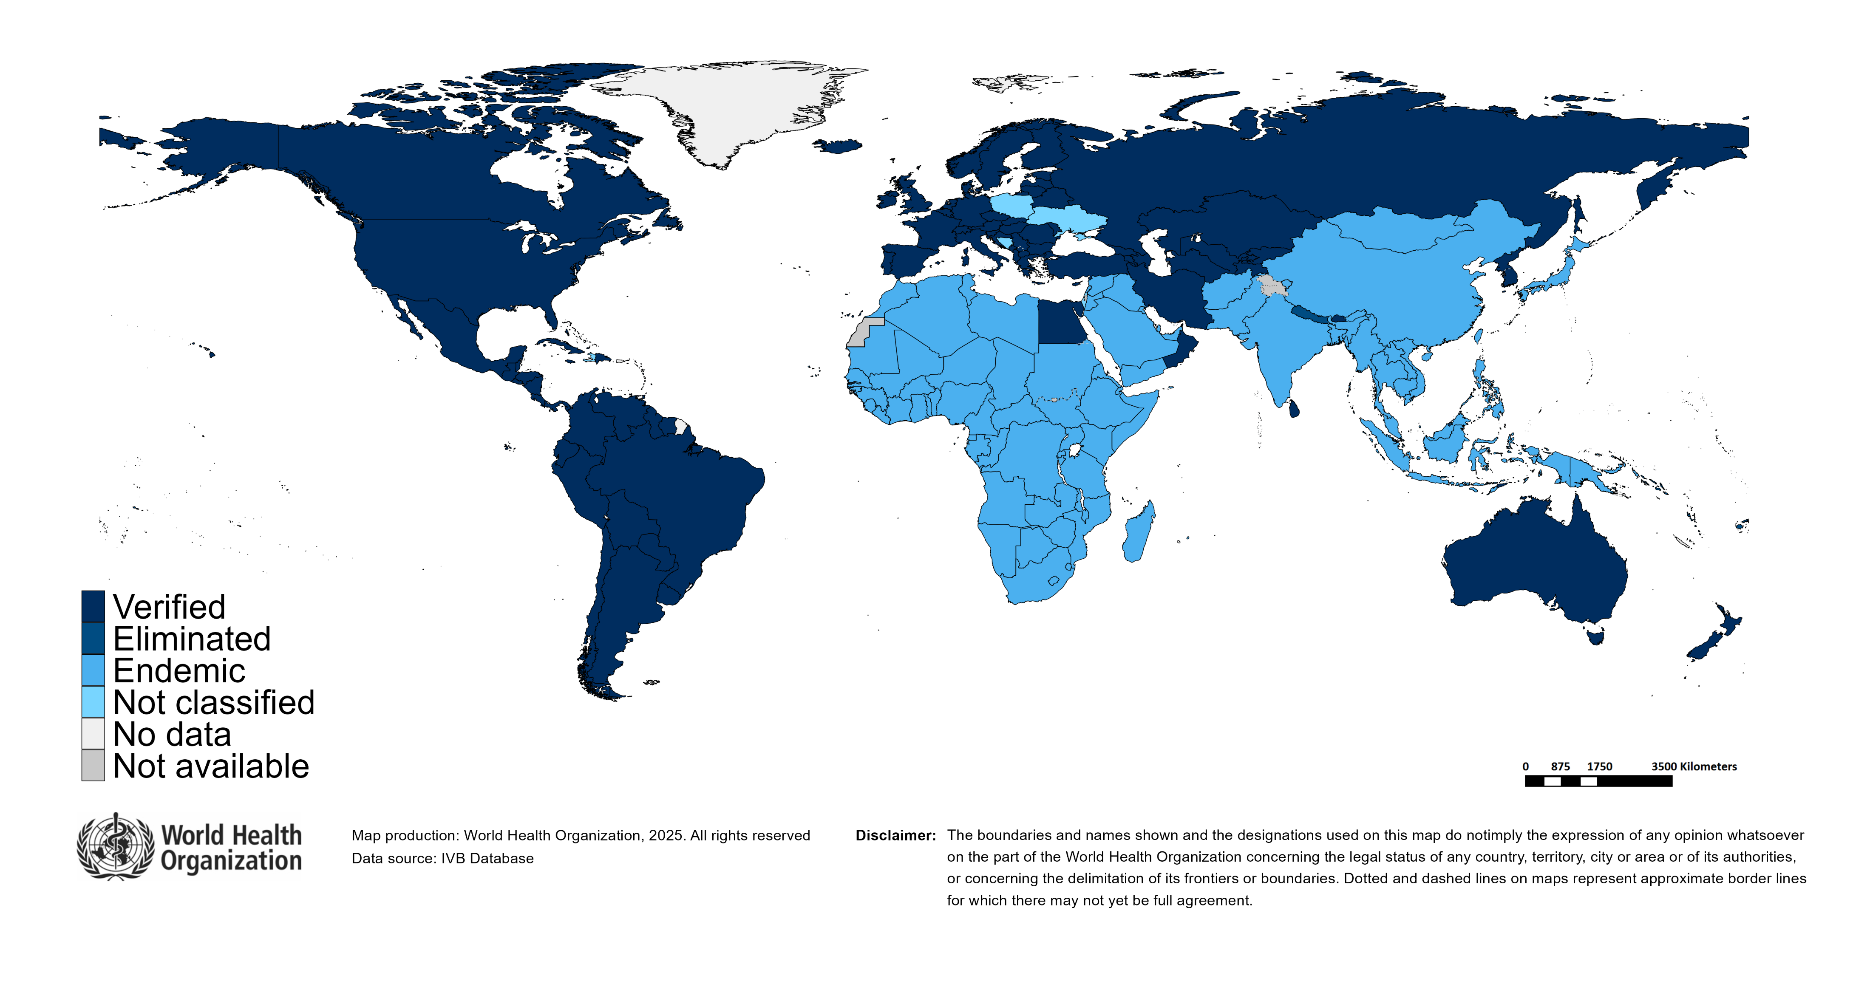
Measles/rubella verification of elimination
Measles
Region | Member States | Verified | % Verified | Eliminated | Endemic | Not classified
AFR | 47 | 0 | 0 | 0 | 47 | 0
AMR | 35 | 34 | 97 | 0 | 0 | 1
EMR | 21 | 4 | 19 | 0 | 17 | 0
EUR | 53 | 33 | 62 | 8 | 11 | 1
SEAR | 11 | 4 | 36 | 0 | 7 | 0
WPR | 27 | 6 | 22 | 13 | 8 | 0
GLOBAL | 194 | 81 | 42 | 21 | 90 | 2
Rubella
Region | Member States | Verified | % Verified | Eliminated | Endemic | Not classified
AFR | 47 | 0 | 0 | 0 | 47 | 0
AMR | 35 | 34 | 97 | 0 | 0 | 1
EMR | 21 | 4 | 19 | 0 | 17 | 0
EUR | 53 | 49 | 92 | 0 | 0 | 4
SEAR | 11 | 5 | 45 | 1 | 5 | 0
WPR | 27 | 5 | 19 | 13 | 9 | 0
GLOBAL | 194 | 97 | 50 | 14 | 78 | 5
Notes: Based on data available at WHO HQ as of 2025-01-13 . Terms used on this slide refer to the global framework for the verification of measles and rubella elimination. These terms might differ from those used by WHO Regional Offices. Verified = Elimination verified by Regional Verification Commitee (RVC); Eliminated = Eliminated transmission but no RVC verification yet.

Slide 8
Measles case distribution by month and WHO Region (2019-2024)
2019
2020
2021
2022
2023
2024
541,401 cases
93,840 cases
59,619 cases
174,374 cases
321,888 cases
320,790 cases
100,000
AFR
AMR
EMR
EUR
SEAR
50,000
WPR
0
Jan
Feb
Mar
Apr
May
Jun
Jul
Aug
Sep
Oct
Nov
Dec
Jan
Feb
Mar
Apr
May
Jun
Jul
Aug
Sep
Oct
Nov
Dec
Jan
Feb
Mar
Apr
May
Jun
Jul
Aug
Sep
Oct
Nov
Dec
Jan
Feb
Mar
Apr
May
Jun
Jul
Aug
Sep
Oct
Nov
Dec
Jan
Feb
Mar
Apr
May
Jun
Jul
Aug
Sep
Oct
Nov
Dec
Jan
Feb
Mar
Apr
May
Jun
Jul
Aug
Sep
Oct
Nov
Dec
Notes: Based on data received 2025-01 - Data Source: IVB Database - This is surveillance data, hence for the last month(s), the data may be incomplete.

Slide 9
Measles case distribution by month and WHO Region (2016-2024)
2016
2017
2018
2019
2020
2021
2022
2023
2024
180,015 cases
168,190 cases
276,157 cases
541,401 cases
93,840 cases
59,619 cases
174,374 cases
321,888 cases
320,790 cases
100,000
50,000
0
May
Sep
Sep
Sep
Sep
Sep
Sep
Sep
Sep
Sep
Apr
Aug
May
Aug
May
Aug
May
Aug
May
Aug
May
Aug
May
Aug
May
Aug
May
Aug
Jan
Feb
Mar
Jun
Jul
Oct
Nov
Jan
Apr
Jun
Jul
Oct
Jan
Apr
Jun
Jul
Oct
Jan
Apr
Jun
Jul
Oct
Jan
Apr
Jun
Jul
Oct
Jan
Apr
Jun
Jul
Oct
Jan
Apr
Jun
Jul
Oct
Jan
Apr
Jun
Jul
Oct
Jan
Apr
Jun
Jul
Oct
Dec
Feb
Mar
Nov
Dec
Feb
Mar
Nov
Dec
Feb
Mar
Nov
Dec
Feb
Mar
Nov
Dec
Feb
Mar
Nov
Dec
Feb
Mar
Nov
Dec
Feb
Mar
Nov
Dec
Feb
Mar
Nov
Dec
Notes: Based on data received 2025-01 - Data Source: IVB Database - This is surveillance data, hence for the last month(s), the data may be incomplete.

Slide 10
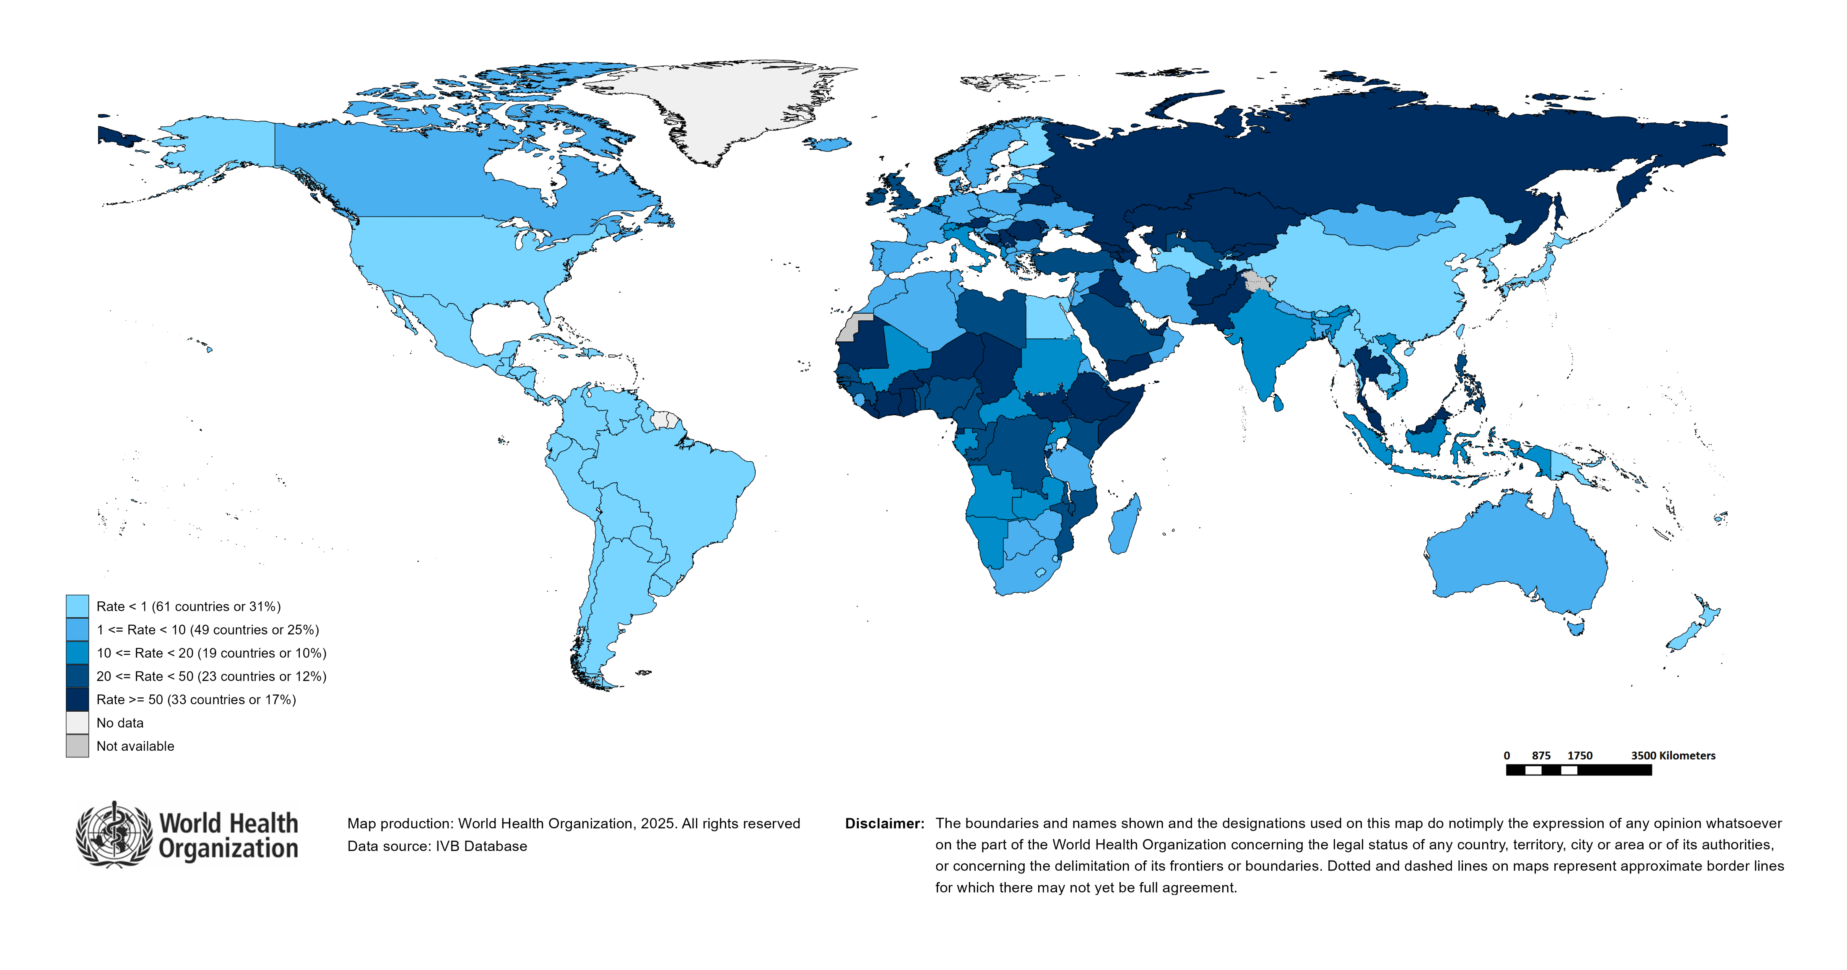
Measles Incidence Rate per Million (12M period)
Highest incidence rates | Highest incidence rates | Highest incidence rates
Country | Cases | Rate
Azerbaijan | 28022 | 2,710.96
Kyrgyzstan | 14890 | 2,072.08
Kazakhstan | 29500 | 1,432.56
Iraq | 34971 | 759.55
Romania | 13011 | 684.25
Yemen | 22112 | 544.86
Bosnia and Herzegovina | 1688 | 533.46
Liberia | 2247 | 400.33
Burkina Faso | 7364 | 312.71
Eq. Guinea | 511 | 270.01
Notes: Based on data received 2025-01 - Surveillance data from 2023-12 to 2024-11 - Incidence: Number of cases / population * 1,000,000 - Population data: World population prospects, 2019 revision

Slide 11
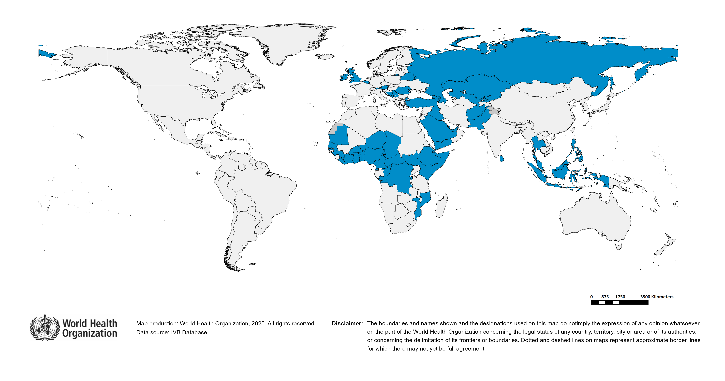
Immunization Agenda 2030 - Impact Goal 1.3
Countries provisionally meeting the large and disruptive outbreaks definition - Data from 2023-09 to 2024-08 included
Country | Cases | Rate/M | Clinical*
Azerbaijan | 30,380 | 2,939.08 | 62%
Kyrgyzstan | 18,101 | 2,518.92 | 41%
Kazakhstan | 38,522 | 1,870.67 | 2%
Iraq | 38,117 | 827.87 | 85%
Romania | 14,386 | 756.56 | 3%
Yemen | 30,075 | 741.07 | 93%
Bosnia and Herzegovina | 1,680 | 530.93 | 80%
Liberia | 2,252 | 401.22 | 19%
Burkina Faso | 7,660 | 325.28 | 15%
Equatorial Guinea | 532 | 281.11 | 58%
Burundi | 3,675 | 261.61 | 2%
South Sudan | 3,124 | 261.57 | 66%
Ethiopia | 33,526 | 253.87 | 0%
Armenia | 676 | 227.32 | 0%
Côte d'Ivoire | 6,675 | 209.02 | 0%
Afghanistan | 7,795 | 182.78 | 0%
Russian Federation | 26,186 | 180.82 | 1%
Malaysia | 4,383 | 123.26 | 9%
Ghana | 4,229 | 122.84 | 1%
Pakistan | 25,983 | 103.41 | 15%
Somalia | 1,657 | 87.17 | 0%
Mauritania | 418 | 80.86 | 0%
Belarus | 686 | 75.75 | 1%
Chad | 1,385 | 68.23 | 9%
United Arab Emirates | 704 | 63.84 | 6%
Uzbekistan | 2,171 | 59.71 | 2%
San Marino | 2 | 59.56 | 0%
Austria | 531 | 58.22 | 0%
Country | Cases | Rate/M | Clinical*
Republic of Moldova | 171 | 56.34 | 1%
Central African Republic | 300 | 56.28 | 1%
Serbia | 366 | 54.33 | 17%
Niger | 1,429 | 52.86 | 29%
Monaco | 2 | 51.77 | 0%
Georgia | 194 | 50.95 | 8%
DR Congo | 5,497 | 50.30 | 2%
Belgium | 585 | 49.83 | 8%
Djibouti | 57 | 48.77 | 0%
Thailand | 3,384 | 47.22 | 16%
Nigeria | 10,766 | 46.27 | 50%
Benin | 590 | 40.79 | 17%
Philippines | 4,706 | 40.62 | 78%
Togo | 385 | 40.46 | 11%
Saudi Arabia | 1,337 | 39.37 | 0%
United Kingdom of Great Britain and Northern Ireland | 2,611 | 37.76 | 0%
Montenegro | 23 | 36.02 | 0%
Sri Lanka | 741 | 32.07 | 4%
Senegal | 554 | 29.94 | 8%
Congo | 187 | 29.53 | 6%
Guinea | 424 | 28.74 | 3%
Cameroon | 818 | 28.09 | 8%
Türkiye | 2,369 | 27.08 | 0%
Kenya | 1,455 | 25.78 | 2%
Indonesia | 7,123 | 25.13 | 61%
Comoros | 20 | 23.08 | 25%
Ireland | 120 | 22.84 | 1%
Qatar | 66 | 21.65 | 2%
Mozambique | 738 | 21.31 | 36%
Total: 57 countries
In the frame of tracking progress towards the goals of Immunization Agenda 2030 (IA2030), an indicator has been developed by a working group in order to represent large and disruptive measles outbreaks. This indicator is defined as an incidence equal or greater than 20 reported measles cases per million population over a period of 12 months. It is important to note that measles outbreak definitions vary between countries and regions according to local context and level of progress towards regional elimination goals. This definition of large and disruptive outbreaks aims to complement and not replace the national and regional definitions, while also providing a degree of global standardization and permitting tracking of progress against a common metric.
Notes: Based on data received 2025-01 and covering the period between 2023-09 and 2024-08 - Incidence: Number of cases / 1M population - Population Data: World population prospects, 2019 revision - A high proportion of clinical cases indicates a high level of uncertainty associated with the incidence rates and the inclusion of countries in this list.

Slide 12
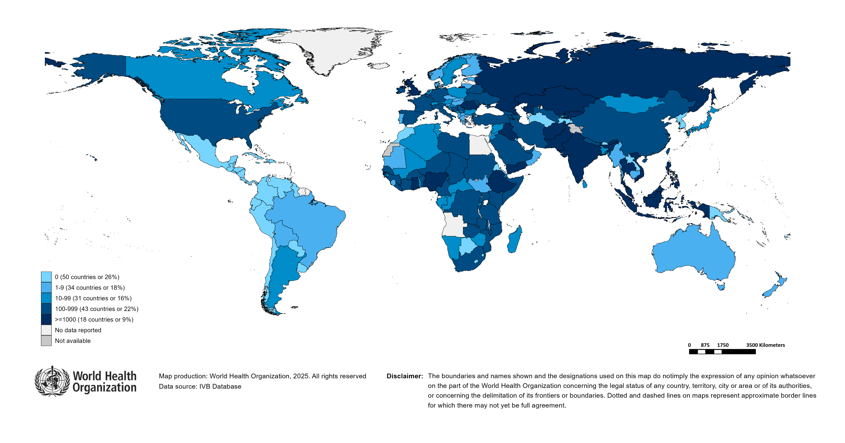
Number of Reported Measles Cases (Last 6 months)
Country | Cases*
Pakistan | 8,571
Yemen | 6,796
Thailand | 6,515
India** | 6,249
Ethiopia | 4,727
Afghanistan | 4,016
Russian Federation | 3,560
Romania | 2,511
Kyrgyzstan | 2,368
Philippines | 1,743
Notes: Based on data received 2025-01 - Surveillance data from 2024-06 to 2024-11 - * Countries with highest number of cases for the period - **WHO classifies all suspected measles cases reported from India as measles clinically compatible if a specimen was not collected as per the algorithm for classification of suspected measles in the WHO VPD Surveillance Standards. Thus numbers might be different between what WHO reports and what India reports.

Slide 13
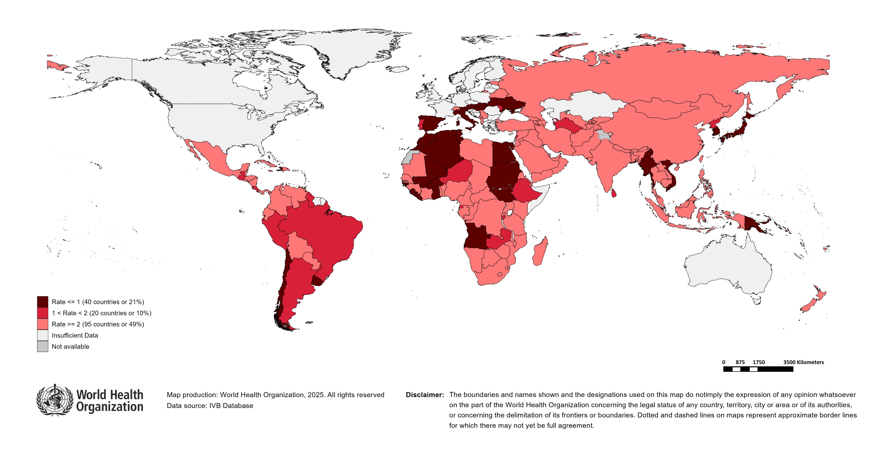
Surveillance sensitivity reporting rate of measles and rubella (12 months, discarded cases* per 100,000 population)
Notes: Based on data received 2025-01 - Surveillance data from 2023-12 to 2024-11 - Target: >= 2 discarded cases* / 100,000 population** - * Suspected cases investigated and discarded as non-measles non-rubella using laboratory testing and/or epidemiological linkage to another etiology ** World population prospects, 2019 revision

Slide 14
Disclaimer
This document contains data provided to WHO by member states. Note that some member states only provide aggregate data to WHO, and for these, we are unable to generate a country profile. Some member states report all cases at one time point for the entire year, and thus epidemiologic curves generated are not accurate and a reporting artifact. For some countries, cases are reported by age category, not by exact age in months and/or years. Thus, age distribution/incidence is approximate. Cases classified as pending by countries are classified at WHO as clinically compatible at this time, and thus numbers might different between data shown here and provided by the member state or WHO country/regional offices.
*UN population data is used as the denominator for calculating incidence.

Slide 15
Measles case distribution (AFR), 2019-2024
2019
2020
2021
2022
2023
2024
Total = 289,766 cases
Total = 46,747 cases
Total = 26,492 cases
Total = 64,922 cases
Total = 73,443 cases
Total = 80,769 cases
75,000
50,000
25,000
0
Jan
Feb
Mar
Apr
May
Jun
Jul
Aug
Sep
Oct
Nov
Dec
Jan
Feb
Mar
Apr
May
Jun
Jul
Aug
Sep
Oct
Nov
Dec
Jan
Feb
Mar
Apr
May
Jun
Jul
Aug
Sep
Oct
Nov
Dec
Jan
Feb
Mar
Apr
May
Jun
Jul
Aug
Sep
Oct
Nov
Dec
Jan
Feb
Mar
Apr
May
Jun
Jul
Aug
Sep
Oct
Nov
Dec
Jan
Feb
Mar
Apr
May
Jun
Jul
Aug
Sep
Oct
Nov
Dec
Cameroon
DR Congo
Ethiopia
Madagascar
Nigeria
Others
Notes: Based on data received 2025-01 - Data Source: IVB Database

Slide 16
Measles cases: Benin
ELIMINATION STATUS:
ENDEMIC
2021
2022
2023
2024
2025
300
27 cases
437 cases
482 cases
659 cases
200
Number of measles cases
100
0
Jan
Feb
Mar
Apr
May
Jun
Jul
Aug
Sep
Oct
Nov
Dec
Jan
Feb
Mar
Apr
May
Jun
Jul
Aug
Sep
Oct
Nov
Dec
Jan
Feb
Mar
Apr
May
Jun
Jul
Aug
Sep
Oct
Nov
Dec
Jan
Feb
Mar
Apr
May
Jun
Jul
Aug
Sep
Oct
Nov
Dec
Jan
Feb
Mar
Apr
May
Jun
Jul
Aug
Sep
Oct
Nov
Dec
Discarded
Clinical
Epi
Lab
Age distribution, vaccination status and incidence (last 12 months)
WHO/UNICEF Coverage Estimates (WUENIC)
100
300
80
200
200
Incidence rate per M
60
Number of cases
% Coverage
100
100
40
0
0
20
<1 yr
1-4 yrs
5-9 yrs
10-14 yrs
15-24 yrs
25-39 yrs
40+ yrs
0
Age at onset (in years)
2000
2001
2002
2003
2004
2005
2006
2007
2008
2009
2010
2011
2012
2013
2014
2015
2016
2017
2018
2019
2020
2021
2022
2023
Incidence
2+ doses
1 dose
0 doses
Unknown
MCV1
MCV2
Based on data received 2025-01 - Data Source: IVB Database. Main epi curve was built using case-based surveillance data. Age distribution curve was built using case-based surveillance data. Coverage data from WHO/UNICEF Estimates of National Immunization Coverage (WUENIC)

Slide 17
Measles cases: Côte d'Ivoire
ELIMINATION STATUS:
ENDEMIC
2021
2022
2023
2024
2025
1,482 cases
1,575 cases
1,338 cases
6,464 cases
2,000
Number of measles cases
1,000
0
Jan
Feb
Mar
Apr
May
Jun
Jul
Aug
Sep
Oct
Nov
Dec
Jan
Feb
Mar
Apr
May
Jun
Jul
Aug
Sep
Oct
Nov
Dec
Jan
Feb
Mar
Apr
May
Jun
Jul
Aug
Sep
Oct
Nov
Dec
Jan
Feb
Mar
Apr
May
Jun
Jul
Aug
Sep
Oct
Nov
Dec
Jan
Feb
Mar
Apr
May
Jun
Jul
Aug
Sep
Oct
Nov
Dec
SIA
Discarded
Clinical
Epi
Lab
Age distribution, vaccination status and incidence (last 12 months)
WHO/UNICEF Coverage Estimates (WUENIC)
100
3,000
900
80
2,000
600
60
Number of cases
Incidence rate per M
1,000
% Coverage
300
40
0
0
20
<1 yr
1-4 yrs
5-9 yrs
10-14 yrs
15-24 yrs
25-39 yrs
40+ yrs
0
Age at onset (in years)
2000
2001
2002
2003
2004
2005
2006
2007
2008
2009
2010
2011
2012
2013
2014
2015
2016
2017
2018
2019
2020
2021
2022
2023
Incidence
2+ doses
1 dose
0 doses
Unknown
MCV1
MCV2
Based on data received 2025-01 - Data Source: IVB Database. Main epi curve was built using case-based surveillance data. Age distribution curve was built using case-based surveillance data. Coverage data from WHO/UNICEF Estimates of National Immunization Coverage (WUENIC)

Slide 18
Measles cases: Democratic Republic of the Congo
ELIMINATION STATUS:
ENDEMIC
2021
2022
2023
2024
2025
3,000
3,443 cases
4,365 cases
10,701 cases
4,489 cases
2,000
Number of measles cases
1,000
0
Jan
Feb
Mar
Apr
May
Jun
Jul
Aug
Sep
Oct
Nov
Dec
Jan
Feb
Mar
Apr
May
Jun
Jul
Aug
Sep
Oct
Nov
Dec
Jan
Feb
Mar
Apr
May
Jun
Jul
Aug
Sep
Oct
Nov
Dec
Jan
Feb
Mar
Apr
May
Jun
Jul
Aug
Sep
Oct
Nov
Dec
Jan
Feb
Mar
Apr
May
Jun
Jul
Aug
Sep
Oct
Nov
Dec
SIA
Discarded
Clinical
Epi
Lab
Age distribution, vaccination status and incidence (last 12 months)
WHO/UNICEF Coverage Estimates (WUENIC)
300
100
2,000
1,500
200
80
Number of cases
1,000
Incidence rate per M
60
100
% Coverage
500
40
0
0
20
<1 yr
1-4 yrs
5-9 yrs
10-14 yrs
15-24 yrs
25-39 yrs
40+ yrs
0
Age at onset (in years)
2000
2001
2002
2003
2004
2005
2006
2007
2008
2009
2010
2011
2012
2013
2014
2015
2016
2017
2018
2019
2020
2021
2022
2023
Incidence
2+ doses
1 dose
0 doses
Unknown
MCV1
MCV2
Based on data received 2025-01 - Data Source: IVB Database. Main epi curve was built using case-based surveillance data. Age distribution curve was built using case-based surveillance data. Coverage data from WHO/UNICEF Estimates of National Immunization Coverage (WUENIC)

Slide 19
Measles cases: Ethiopia
ELIMINATION STATUS:
ENDEMIC
2021
2022
2023
2024
2025
1,947 cases
8,216 cases
16,505 cases
28,139 cases
7,500
5,000
Number of measles cases
2,500
0
Jan
Feb
Mar
Apr
May
Jun
Jul
Aug
Sep
Oct
Nov
Dec
Jan
Feb
Mar
Apr
May
Jun
Jul
Aug
Sep
Oct
Nov
Dec
Jan
Feb
Mar
Apr
May
Jun
Jul
Aug
Sep
Oct
Nov
Dec
Jan
Feb
Mar
Apr
May
Jun
Jul
Aug
Sep
Oct
Nov
Dec
Jan
Feb
Mar
Apr
May
Jun
Jul
Aug
Sep
Oct
Nov
Dec
SIA
Discarded
Clinical
Epi
Lab
Age distribution, vaccination status and incidence (last 12 months)
WHO/UNICEF Coverage Estimates (WUENIC)
12,000
100
9,000
750
80
6,000
500
60
Number of cases
Incidence rate per M
% Coverage
3,000
250
40
0
0
20
<1 yr
1-4 yrs
5-9 yrs
10-14 yrs
15-24 yrs
25-39 yrs
40+ yrs
0
Age at onset (in years)
2000
2001
2002
2003
2004
2005
2006
2007
2008
2009
2010
2011
2012
2013
2014
2015
2016
2017
2018
2019
2020
2021
2022
2023
Incidence
2+ doses
1 dose
0 doses
Unknown
MCV1
MCV2
Based on data received 2025-01 - Data Source: IVB Database. Main epi curve was built using case-based surveillance data. Age distribution curve was built using case-based surveillance data. Coverage data from WHO/UNICEF Estimates of National Immunization Coverage (WUENIC)

Slide 20
Measles cases: Ghana
ELIMINATION STATUS:
ENDEMIC
2021
2022
2023
2024
2025
1,200
58 cases
242 cases
2,279 cases
4,189 cases
900
600
Number of measles cases
300
0
Jan
Feb
Mar
Apr
May
Jun
Jul
Aug
Sep
Oct
Nov
Dec
Jan
Feb
Mar
Apr
May
Jun
Jul
Aug
Sep
Oct
Nov
Dec
Jan
Feb
Mar
Apr
May
Jun
Jul
Aug
Sep
Oct
Nov
Dec
Jan
Feb
Mar
Apr
May
Jun
Jul
Aug
Sep
Oct
Nov
Dec
Jan
Feb
Mar
Apr
May
Jun
Jul
Aug
Sep
Oct
Nov
Dec
SIA
Discarded
Clinical
Epi
Lab
Age distribution, vaccination status and incidence (last 12 months)
WHO/UNICEF Coverage Estimates (WUENIC)
40
50
100
30
40
80
30
60
Number of cases
Incidence rate per M
20
20
% Coverage
10
10
40
0
0
20
<1 yr
1-4 yrs
5-9 yrs
10-14 yrs
15-24 yrs
25-39 yrs
40+ yrs
0
Age at onset (in years)
2000
2001
2002
2003
2004
2005
2006
2007
2008
2009
2010
2011
2012
2013
2014
2015
2016
2017
2018
2019
2020
2021
2022
2023
Incidence
2+ doses
1 dose
0 doses
Unknown
MCV1
MCV2
Based on data received 2025-01 - Data Source: IVB Database. Main epi curve was built using case-based surveillance data. Age distribution curve was built using case-based surveillance data. Coverage data from WHO/UNICEF Estimates of National Immunization Coverage (WUENIC)

Slide 21
Measles cases: Guinea
ELIMINATION STATUS:
ENDEMIC
2021
2022
2023
2024
2025
300
474 cases
429 cases
204 cases
549 cases
200
Number of measles cases
100
0
Jan
Feb
Mar
Apr
May
Jun
Jul
Aug
Sep
Oct
Nov
Dec
Jan
Feb
Mar
Apr
May
Jun
Jul
Aug
Sep
Oct
Nov
Dec
Jan
Feb
Mar
Apr
May
Jun
Jul
Aug
Sep
Oct
Nov
Dec
Jan
Feb
Mar
Apr
May
Jun
Jul
Aug
Sep
Oct
Nov
Dec
Jan
Feb
Mar
Apr
May
Jun
Jul
Aug
Sep
Oct
Nov
Dec
SIA
Discarded
Clinical
Epi
Lab
Age distribution, vaccination status and incidence (last 12 months)
WHO/UNICEF Coverage Estimates (WUENIC)
100
300
200
80
200
150
Number of cases
Incidence rate per M
60
100
% Coverage
100
50
40
0
0
20
<1 yr
1-4 yrs
5-9 yrs
10-14 yrs
15-24 yrs
25-39 yrs
40+ yrs
0
Age at onset (in years)
2000
2001
2002
2003
2004
2005
2006
2007
2008
2009
2010
2011
2012
2013
2014
2015
2016
2017
2018
2019
2020
2021
2022
2023
Incidence
2+ doses
1 dose
0 doses
Unknown
MCV1
MCV2
Based on data received 2025-01 - Data Source: IVB Database. Main epi curve was built using case-based surveillance data. Age distribution curve was built using case-based surveillance data. Coverage data from WHO/UNICEF Estimates of National Immunization Coverage (WUENIC)

Slide 22
Measles cases: Mozambique
ELIMINATION STATUS:
ENDEMIC
2021
2022
2023
2024
2025
600
884 cases
676 cases
664 cases
683 cases
400
Number of measles cases
200
0
Jan
Feb
Mar
Apr
May
Jun
Jul
Aug
Sep
Oct
Nov
Dec
Jan
Feb
Mar
Apr
May
Jun
Jul
Aug
Sep
Oct
Nov
Dec
Jan
Feb
Mar
Apr
May
Jun
Jul
Aug
Sep
Oct
Nov
Dec
Jan
Feb
Mar
Apr
May
Jun
Jul
Aug
Sep
Oct
Nov
Dec
Jan
Feb
Mar
Apr
May
Jun
Jul
Aug
Sep
Oct
Nov
Dec
SIA
Discarded
Clinical
Epi
Lab
Age distribution, vaccination status and incidence (last 12 months)
WHO/UNICEF Coverage Estimates (WUENIC)
100
200
75
80
50
60
Number of cases
Incidence rate per M
100
% Coverage
25
40
0
0
20
<1 yr
1-4 yrs
5-9 yrs
10-14 yrs
15-24 yrs
25-39 yrs
40+ yrs
0
Age at onset (in years)
2000
2001
2002
2003
2004
2005
2006
2007
2008
2009
2010
2011
2012
2013
2014
2015
2016
2017
2018
2019
2020
2021
2022
2023
Incidence
2+ doses
1 dose
0 doses
Unknown
MCV1
MCV2
Based on data received 2025-01 - Data Source: IVB Database. Main epi curve was built using case-based surveillance data. Age distribution curve was built using case-based surveillance data. Coverage data from WHO/UNICEF Estimates of National Immunization Coverage (WUENIC)

Slide 23
Measles cases: Nigeria
ELIMINATION STATUS:
ENDEMIC
2021
2022
2023
2024
2025
10,871 cases
20,748 cases
12,224 cases
10,237 cases
7,500
5,000
Number of measles cases
2,500
0
Jan
Feb
Mar
Apr
May
Jun
Jul
Aug
Sep
Oct
Nov
Dec
Jan
Feb
Mar
Apr
May
Jun
Jul
Aug
Sep
Oct
Nov
Dec
Jan
Feb
Mar
Apr
May
Jun
Jul
Aug
Sep
Oct
Nov
Dec
Jan
Feb
Mar
Apr
May
Jun
Jul
Aug
Sep
Oct
Nov
Dec
Jan
Feb
Mar
Apr
May
Jun
Jul
Aug
Sep
Oct
Nov
Dec
SIA
Discarded
Clinical
Epi
Lab
6,000
Age distribution, vaccination status and incidence (last 12 months)
WHO/UNICEF Coverage Estimates (WUENIC)
250
100
200
80
4,000
150
Number of cases
Incidence rate per M
60
2,000
100
% Coverage
50
40
0
0
20
<1 yr
1-4 yrs
5-9 yrs
10-14 yrs
15-24 yrs
25-39 yrs
40+ yrs
0
Age at onset (in years)
2000
2001
2002
2003
2004
2005
2006
2007
2008
2009
2010
2011
2012
2013
2014
2015
2016
2017
2018
2019
2020
2021
2022
2023
Incidence
2+ doses
1 dose
0 doses
Unknown
MCV1
MCV2
Based on data received 2025-01 - Data Source: IVB Database. Main epi curve was built using case-based surveillance data. Age distribution curve was built using case-based surveillance data. Coverage data from WHO/UNICEF Estimates of National Immunization Coverage (WUENIC)

Slide 24
Measles case distribution (AMR), 2019-2024
2019
2020
2021
2022
2023
2024
Total = 23,279 cases
Total = 8,708 cases
Total = 712 cases
Total = 169 cases
Total = 73 cases
Total = 455 cases
6,000
4,000
2,000
0
Jan
Feb
Mar
Apr
May
Jun
Jul
Aug
Sep
Oct
Nov
Dec
Jan
Feb
Mar
Apr
May
Jun
Jul
Aug
Sep
Oct
Nov
Dec
Jan
Feb
Mar
Apr
May
Jun
Jul
Aug
Sep
Oct
Nov
Dec
Jan
Feb
Mar
Apr
May
Jun
Jul
Aug
Sep
Oct
Nov
Dec
Jan
Feb
Mar
Apr
May
Jun
Jul
Aug
Sep
Oct
Nov
Dec
Jan
Feb
Mar
Apr
May
Jun
Jul
Aug
Sep
Oct
Nov
Dec
Brazil
Canada
Colombia
Others
USA
Venezuela (Bolivarian Republic of)
Notes: Based on data received 2025-01 - Data Source: IVB Database

Slide 25
Measles case distribution (EMR), 2019-2024
2019
2020
2021
2022
2023
2024
Total = 30,703 cases
Total = 9,829 cases
Total = 24,329 cases
Total = 57,465 cases
Total = 90,855 cases
Total = 90,007 cases
15,000
10,000
5,000
0
Jan
Feb
Mar
Apr
May
Jun
Jul
Aug
Sep
Oct
Nov
Dec
Jan
Feb
Mar
Apr
May
Jun
Jul
Aug
Sep
Oct
Nov
Dec
Jan
Feb
Mar
Apr
May
Jun
Jul
Aug
Sep
Oct
Nov
Dec
Jan
Feb
Mar
Apr
May
Jun
Jul
Aug
Sep
Oct
Nov
Dec
Jan
Feb
Mar
Apr
May
Jun
Jul
Aug
Sep
Oct
Nov
Dec
Jan
Feb
Mar
Apr
May
Jun
Jul
Aug
Sep
Oct
Nov
Dec
Afghanistan
Iraq
Others
Pakistan
Somalia
Yemen
Notes: Based on data received 2025-01 - Data Source: IVB Database

Slide 26
Measles cases: Afghanistan
ELIMINATION STATUS:
ENDEMIC
2021
2022
2023
2024
2025
3,000
3,028 cases
5,119 cases
2,529 cases
9,596 cases
2,000
Number of measles cases
1,000
0
Jan
Feb
Mar
Apr
May
Jun
Jul
Aug
Sep
Oct
Nov
Dec
Jan
Feb
Mar
Apr
May
Jun
Jul
Aug
Sep
Oct
Nov
Dec
Jan
Feb
Mar
Apr
May
Jun
Jul
Aug
Sep
Oct
Nov
Dec
Jan
Feb
Mar
Apr
May
Jun
Jul
Aug
Sep
Oct
Nov
Dec
Jan
Feb
Mar
Apr
May
Jun
Jul
Aug
Sep
Oct
Nov
Dec
SIA
Discarded
Clinical
Epi
Lab
Age distribution, vaccination status and incidence (last 12 months)
WHO/UNICEF Coverage Estimates (WUENIC)
4,000
2000
100
3,000
1500
80
Number of cases
2,000
Incidence rate per M
60
1000
% Coverage
1,000
500
40
0
0
20
<1 yr
1-4 yrs
5-9 yrs
10-14 yrs
15-24 yrs
25-39 yrs
40+ yrs
0
Age at onset (in years)
2000
2001
2002
2003
2004
2005
2006
2007
2008
2009
2010
2011
2012
2013
2014
2015
2016
2017
2018
2019
2020
2021
2022
2023
Incidence
2+ doses
1 dose
0 doses
Unknown
MCV1
MCV2
Based on data received 2025-01 - Data Source: IVB Database. Main epi curve was built using case-based surveillance data. Age distribution curve was built using case-based surveillance data. Coverage data from WHO/UNICEF Estimates of National Immunization Coverage (WUENIC)

Slide 27
Measles cases: Pakistan
ELIMINATION STATUS:
ENDEMIC
2021
2022
2023
2024
2025
12,000
9,313 cases
7,917 cases
17,515 cases
23,596 cases
8,000
Number of measles cases
4,000
0
Jan
Feb
Mar
Apr
May
Jun
Jul
Aug
Sep
Oct
Nov
Dec
Jan
Feb
Mar
Apr
May
Jun
Jul
Aug
Sep
Oct
Nov
Dec
Jan
Feb
Mar
Apr
May
Jun
Jul
Aug
Sep
Oct
Nov
Dec
Jan
Feb
Mar
Apr
May
Jun
Jul
Aug
Sep
Oct
Nov
Dec
Jan
Feb
Mar
Apr
May
Jun
Jul
Aug
Sep
Oct
Nov
Dec
SIA
Discarded
Clinical
Epi
Lab
Age distribution, vaccination status and incidence (last 12 months)
WHO/UNICEF Coverage Estimates (WUENIC)
100
10,000
1000
80
Number of cases
Incidence rate per M
60
5,000
500
% Coverage
40
0
0
20
<1 yr
1-4 yrs
5-9 yrs
10-14 yrs
15-24 yrs
25-39 yrs
40+ yrs
0
Age at onset (in years)
2000
2001
2002
2003
2004
2005
2006
2007
2008
2009
2010
2011
2012
2013
2014
2015
2016
2017
2018
2019
2020
2021
2022
2023
Incidence
2+ doses
1 dose
0 doses
Unknown
MCV1
MCV2
Based on data received 2025-01 - Data Source: IVB Database. Main epi curve was built using case-based surveillance data. Age distribution curve was built using case-based surveillance data. Coverage data from WHO/UNICEF Estimates of National Immunization Coverage (WUENIC)

Slide 28
Measles cases: Somalia
ELIMINATION STATUS:
ENDEMIC
2021
2022
2023
2024
2025
3,000
6,029 cases
17,361 cases
1,781 cases
1,309 cases
2,000
Number of measles cases
1,000
0
Jan
Feb
Mar
Apr
May
Jun
Jul
Aug
Sep
Oct
Nov
Dec
Jan
Feb
Mar
Apr
May
Jun
Jul
Aug
Sep
Oct
Nov
Dec
Jan
Feb
Mar
Apr
May
Jun
Jul
Aug
Sep
Oct
Nov
Dec
Jan
Feb
Mar
Apr
May
Jun
Jul
Aug
Sep
Oct
Nov
Dec
Jan
Feb
Mar
Apr
May
Jun
Jul
Aug
Sep
Oct
Nov
Dec
SIA
Discarded
Clinical
Epi
Lab
Age distribution, vaccination status and incidence (last 12 months)
WHO/UNICEF Coverage Estimates (WUENIC)
1,250
100
1,000
1500
80
750
1000
60
Number of cases
500
Incidence rate per M
% Coverage
250
500
40
0
0
20
<1 yr
1-4 yrs
5-9 yrs
10-14 yrs
15-24 yrs
25-39 yrs
40+ yrs
0
Age at onset (in years)
2000
2001
2002
2003
2004
2005
2006
2007
2008
2009
2010
2011
2012
2013
2014
2015
2016
2017
2018
2019
2020
2021
2022
2023
Incidence
1 dose
0 doses
Unknown
MCV1
MCV2
Based on data received 2025-01 - Data Source: IVB Database. Main epi curve was built using a combination of case-based and aggregate surveillance data. Age distribution curve was built using case-based surveillance data. Coverage data from WHO/UNICEF Estimates of National Immunization Coverage (WUENIC)

Slide 29
Measles cases: Yemen
ELIMINATION STATUS:
ENDEMIC
2021
2022
2023
2024
2025
8,000
4,825 cases
23,924 cases
49,571 cases
19,988 cases
6,000
4,000
Number of measles cases
2,000
0
Jan
Feb
Mar
Apr
May
Jun
Jul
Aug
Sep
Oct
Nov
Dec
Jan
Feb
Mar
Apr
May
Jun
Jul
Aug
Sep
Oct
Nov
Dec
Jan
Feb
Mar
Apr
May
Jun
Jul
Aug
Sep
Oct
Nov
Dec
Jan
Feb
Mar
Apr
May
Jun
Jul
Aug
Sep
Oct
Nov
Dec
Jan
Feb
Mar
Apr
May
Jun
Jul
Aug
Sep
Oct
Nov
Dec
SIA
Discarded
Clinical
Epi
Lab
Age distribution, vaccination status and incidence (last 12 months)
WHO/UNICEF Coverage Estimates (WUENIC)
100
9,000
3000
80
6,000
2000
60
Number of cases
Incidence rate per M
1000
% Coverage
3,000
40
0
0
20
<1 yr
1-4 yrs
5-9 yrs
10-14 yrs
15-24 yrs
25-39 yrs
40+ yrs
0
Age at onset (in years)
2000
2001
2002
2003
2004
2005
2006
2007
2008
2009
2010
2011
2012
2013
2014
2015
2016
2017
2018
2019
2020
2021
2022
2023
Incidence
2+ doses
1 dose
0 doses
Unknown
MCV1
MCV2
Based on data received 2025-01 - Data Source: IVB Database. Main epi curve was built using case-based surveillance data. Age distribution curve was built using case-based surveillance data. Coverage data from WHO/UNICEF Estimates of National Immunization Coverage (WUENIC)

Slide 30
Measles case distribution (EUR), 2019-2024
2019
2020
2021
2022
2023
2024
30,000
Total = 104,442 cases
Total = 12,193 cases
Total = 150 cases
Total = 935 cases
Total = 60,943 cases
Total = 106,237 cases
20,000
10,000
0
Jan
Feb
Mar
Apr
May
Jun
Jul
Aug
Sep
Oct
Nov
Dec
Jan
Feb
Mar
Apr
May
Jun
Jul
Aug
Sep
Oct
Nov
Dec
Jan
Feb
Mar
Apr
May
Jun
Jul
Aug
Sep
Oct
Nov
Dec
Jan
Feb
Mar
Apr
May
Jun
Jul
Aug
Sep
Oct
Nov
Dec
Jan
Feb
Mar
Apr
May
Jun
Jul
Aug
Sep
Oct
Nov
Dec
Jan
Feb
Mar
Apr
May
Jun
Jul
Aug
Sep
Oct
Nov
Dec
Azerbaijan
Kazakhstan
Kyrgyzstan
Others
Russian Federation
Ukraine
Notes: Based on data received 2025-01 - Data Source: IVB Database

Slide 31
Measles cases: Georgia
ELIMINATION STATUS:
ENDEMIC
2021
2022
2023
2024
2025
120
5 cases
12 cases
39 cases
312 cases
80
Number of measles cases
40
0
Jan
Feb
Mar
Apr
May
Jun
Jul
Aug
Sep
Oct
Nov
Dec
Jan
Feb
Mar
Apr
May
Jun
Jul
Aug
Sep
Oct
Nov
Dec
Jan
Feb
Mar
Apr
May
Jun
Jul
Aug
Sep
Oct
Nov
Dec
Jan
Feb
Mar
Apr
May
Jun
Jul
Aug
Sep
Oct
Nov
Dec
Jan
Feb
Mar
Apr
May
Jun
Jul
Aug
Sep
Oct
Nov
Dec
Discarded
Clinical
Epi
Lab
Age distribution, vaccination status and incidence (last 12 months)
WHO/UNICEF Coverage Estimates (WUENIC)
100
100
75
200
80
Number of cases
Incidence rate per M
60
50
% Coverage
25
100
40
0
0
20
<1 yr
1-4 yrs
5-9 yrs
10-14 yrs
15-24 yrs
25-39 yrs
40+ yrs
0
Age at onset (in years)
2000
2001
2002
2003
2004
2005
2006
2007
2008
2009
2010
2011
2012
2013
2014
2015
2016
2017
2018
2019
2020
2021
2022
2023
Incidence
2+ doses
1 dose
0 doses
Unknown
MCV1
MCV2
Based on data received 2025-01 - Data Source: IVB Database. Main epi curve was built using case-based surveillance data. Age distribution curve was built using case-based surveillance data. Coverage data from WHO/UNICEF Estimates of National Immunization Coverage (WUENIC)

Slide 32
Measles cases: Ireland
ELIMINATION STATUS:
VERIFIED
2021
2022
2023
2024
2025
40
4 cases
2 cases
4 cases
185 cases
30
Number of measles cases
20
10
0
Jan
Feb
Mar
Apr
May
Jun
Jul
Aug
Sep
Oct
Nov
Dec
Jan
Feb
Mar
Apr
May
Jun
Jul
Aug
Sep
Oct
Nov
Dec
Jan
Feb
Mar
Apr
May
Jun
Jul
Aug
Sep
Oct
Nov
Dec
Jan
Feb
Mar
Apr
May
Jun
Jul
Aug
Sep
Oct
Nov
Dec
Jan
Feb
Mar
Apr
May
Jun
Jul
Aug
Sep
Oct
Nov
Dec
Discarded
Clinical
Epi
Lab
Age distribution, vaccination status and incidence (last 12 months)
WHO/UNICEF Coverage Estimates (WUENIC)
100
30
200
80
20
Incidence rate per M
60
Number of cases
% Coverage
10
100
40
0
0
20
<1 yr
1-4 yrs
5-9 yrs
10-14 yrs
15-24 yrs
25-39 yrs
40+ yrs
0
Age at onset (in years)
2000
2001
2002
2003
2004
2005
2006
2007
2008
2009
2010
2011
2012
2013
2014
2015
2016
2017
2018
2019
2020
2021
2022
2023
Incidence
2+ doses
1 dose
0 doses
Unknown
MCV1
MCV2
Based on data received 2025-01 - Data Source: IVB Database. Main epi curve was built using case-based surveillance data. Age distribution curve was built using case-based surveillance data. Coverage data from WHO/UNICEF Estimates of National Immunization Coverage (WUENIC)

Slide 33
Measles cases: Romania
ELIMINATION STATUS:
ENDEMIC
2021
2022
2023
2024
2025
1 cases
9 cases
3,371 cases
12,040 cases
2,000
Number of measles cases
1,000
0
Jan
Feb
Mar
Apr
May
Jun
Jul
Aug
Sep
Oct
Nov
Dec
Jan
Feb
Mar
Apr
May
Jun
Jul
Aug
Sep
Oct
Nov
Dec
Jan
Feb
Mar
Apr
May
Jun
Jul
Aug
Sep
Oct
Nov
Dec
Jan
Feb
Mar
Apr
May
Jun
Jul
Aug
Sep
Oct
Nov
Dec
Jan
Feb
Mar
Apr
May
Jun
Jul
Aug
Sep
Oct
Nov
Dec
Discarded
Clinical
Epi
Lab
Age distribution, vaccination status and incidence (last 12 months)
WHO/UNICEF Coverage Estimates (WUENIC)
100
4,000
9000
3,000
80
6000
60
Number of cases
2,000
Incidence rate per M
% Coverage
1,000
3000
40
0
0
20
<1 yr
1-4 yrs
5-9 yrs
10-14 yrs
15-24 yrs
25-39 yrs
40+ yrs
0
Age at onset (in years)
2000
2001
2002
2003
2004
2005
2006
2007
2008
2009
2010
2011
2012
2013
2014
2015
2016
2017
2018
2019
2020
2021
2022
2023
Incidence
2+ doses
1 dose
0 doses
Unknown
MCV1
MCV2
Based on data received 2025-01 - Data Source: IVB Database. Main epi curve was built using case-based surveillance data. Age distribution curve was built using case-based surveillance data. Coverage data from WHO/UNICEF Estimates of National Immunization Coverage (WUENIC)

Slide 34
Measles cases: Russian Federation
ELIMINATION STATUS:
ELIMINATED
2021
2022
2023
2024
2025
1 cases
117 cases
12,960 cases
21,682 cases
6,000
4,000
Number of measles cases
2,000
0
Jan
Feb
Mar
Apr
May
Jun
Jul
Aug
Sep
Oct
Nov
Dec
Jan
Feb
Mar
Apr
May
Jun
Jul
Aug
Sep
Oct
Nov
Dec
Jan
Feb
Mar
Apr
May
Jun
Jul
Aug
Sep
Oct
Nov
Dec
Jan
Feb
Mar
Apr
May
Jun
Jul
Aug
Sep
Oct
Nov
Dec
Jan
Feb
Mar
Apr
May
Jun
Jul
Aug
Sep
Oct
Nov
Dec
Discarded
Clinical
Epi
Lab
Age distribution, vaccination status and incidence (last 12 months)
WHO/UNICEF Coverage Estimates (WUENIC)
100
4,000
1500
80
1000
60
Number of cases
Incidence rate per M
2,000
% Coverage
500
40
0
0
20
<1 yr
1-4 yrs
5-9 yrs
10-14 yrs
15-24 yrs
25-39 yrs
40+ yrs
0
Age at onset (in years)
2000
2001
2002
2003
2004
2005
2006
2007
2008
2009
2010
2011
2012
2013
2014
2015
2016
2017
2018
2019
2020
2021
2022
2023
Incidence
2+ doses
1 dose
0 doses
Unknown
MCV1
MCV2
Based on data received 2025-01 - Data Source: IVB Database. Main epi curve was built using case-based surveillance data. Age distribution curve was built using case-based surveillance data. Coverage data from WHO/UNICEF Estimates of National Immunization Coverage (WUENIC)

Slide 35
Measles cases: Serbia
ELIMINATION STATUS:
ENDEMIC
2021
2022
2023
2024
2025
200
1 cases
0 cases
52 cases
695 cases
150
100
Number of measles cases
50
0
Jan
Feb
Mar
Apr
May
Jun
Jul
Aug
Sep
Oct
Nov
Dec
Jan
Feb
Mar
Apr
May
Jun
Jul
Aug
Sep
Oct
Nov
Dec
Jan
Feb
Mar
Apr
May
Jun
Jul
Aug
Sep
Oct
Nov
Dec
Jan
Feb
Mar
Apr
May
Jun
Jul
Aug
Sep
Oct
Nov
Dec
Jan
Feb
Mar
Apr
May
Jun
Jul
Aug
Sep
Oct
Nov
Dec
Discarded
Clinical
Epi
Lab
WHO/UNICEF Coverage Estimates (WUENIC)
100
80
60
% Coverage
40
20
0
2000
2001
2002
2003
2004
2005
2006
2007
2008
2009
2010
2011
2012
2013
2014
2015
2016
2017
2018
2019
2020
2021
2022
2023
MCV1
MCV2
Based on data received 2025-01 - Data Source: IVB Database. Main epi curve was built using a combination of case-based and aggregate surveillance data. Coverage data from WHO/UNICEF Estimates of National Immunization Coverage (WUENIC)

Slide 36
Measles cases: United Kingdom of Great Britain and Northern Ireland
ELIMINATION STATUS:
VERIFIED
2021
2022
2023
2024
2025
500
2 cases
50 cases
231 cases
2,915 cases
400
300
Number of measles cases
200
100
0
Jan
Feb
Mar
Apr
May
Jun
Jul
Aug
Sep
Oct
Nov
Dec
Jan
Feb
Mar
Apr
May
Jun
Jul
Aug
Sep
Oct
Nov
Dec
Jan
Feb
Mar
Apr
May
Jun
Jul
Aug
Sep
Oct
Nov
Dec
Jan
Feb
Mar
Apr
May
Jun
Jul
Aug
Sep
Oct
Nov
Dec
Jan
Feb
Mar
Apr
May
Jun
Jul
Aug
Sep
Oct
Nov
Dec
Discarded
Clinical
Epi
Lab
Age distribution, vaccination status and incidence (last 12 months)
WHO/UNICEF Coverage Estimates (WUENIC)
500
100
600
400
80
400
300
60
Number of cases
Incidence rate per M
200
% Coverage
200
100
40
0
0
20
<1 yr
1-4 yrs
5-9 yrs
10-14 yrs
15-24 yrs
25-39 yrs
40+ yrs
0
Age at onset (in years)
2000
2001
2002
2003
2004
2005
2006
2007
2008
2009
2010
2011
2012
2013
2014
2015
2016
2017
2018
2019
2020
2021
2022
2023
Incidence
2+ doses
1 dose
0 doses
MCV1
MCV2
Based on data received 2025-01 - Data Source: IVB Database. Main epi curve was built using case-based surveillance data. Age distribution curve was built using case-based surveillance data. Coverage data from WHO/UNICEF Estimates of National Immunization Coverage (WUENIC)

Slide 37
Measles case distribution (SEAR (excl. India)), 2019-2024
2019
2020
2021
2022
2023
2024
Total = 18,431 cases
Total = 4,452 cases
Total = 715 cases
Total = 5,914 cases
Total = 22,038 cases
Total = 12,986 cases
3,000
2,000
1,000
0
Jan
Feb
Mar
Apr
May
Jun
Jul
Aug
Sep
Oct
Nov
Dec
Jan
Feb
Mar
Apr
May
Jun
Jul
Aug
Sep
Oct
Nov
Dec
Jan
Feb
Mar
Apr
May
Jun
Jul
Aug
Sep
Oct
Nov
Dec
Jan
Feb
Mar
Apr
May
Jun
Jul
Aug
Sep
Oct
Nov
Dec
Jan
Feb
Mar
Apr
May
Jun
Jul
Aug
Sep
Oct
Nov
Dec
Jan
Feb
Mar
Apr
May
Jun
Jul
Aug
Sep
Oct
Nov
Dec
Bangladesh
Indonesia
Myanmar
Nepal
Others
Thailand
Notes: Based on data received 2025-01 - Data Source: IVB Database

Slide 38
Measles cases: Indonesia
ELIMINATION STATUS:
ENDEMIC
2021
2022
2023
2024
2025
8,000
290 cases
5,362 cases
19,879 cases
4,718 cases
6,000
Number of measles cases
4,000
2,000
0
Jan
Feb
Mar
Apr
May
Jun
Jul
Aug
Sep
Oct
Nov
Dec
Jan
Feb
Mar
Apr
May
Jun
Jul
Aug
Sep
Oct
Nov
Dec
Jan
Feb
Mar
Apr
May
Jun
Jul
Aug
Sep
Oct
Nov
Dec
Jan
Feb
Mar
Apr
May
Jun
Jul
Aug
Sep
Oct
Nov
Dec
Jan
Feb
Mar
Apr
May
Jun
Jul
Aug
Sep
Oct
Nov
Dec
SIA
Discarded
Clinical
Epi
Lab
Age distribution, vaccination status and incidence (last 12 months)
WHO/UNICEF Coverage Estimates (WUENIC)
3
0.20
100
2
0.15
80
Number of cases
Incidence rate per M
60
0.10
% Coverage
1
0.05
40
0
0.00
20
<1 yr
1-4 yrs
5-9 yrs
10-14 yrs
15-24 yrs
25-39 yrs
40+ yrs
0
Age at onset (in years)
2000
2001
2002
2003
2004
2005
2006
2007
2008
2009
2010
2011
2012
2013
2014
2015
2016
2017
2018
2019
2020
2021
2022
2023
Incidence
Unknown
MCV1
MCV2
Based on data received 2025-01 - Data Source: IVB Database. Main epi curve was built using aggregate surveillance data. Age distribution curve was built using case-based surveillance data. Coverage data from WHO/UNICEF Estimates of National Immunization Coverage (WUENIC)

Slide 39
Measles cases: Thailand
ELIMINATION STATUS:
ENDEMIC
2021
2022
2023
2024
2025
70 cases
63 cases
38 cases
7,507 cases
2,000
Number of measles cases
1,000
0
Jan
Feb
Mar
Apr
May
Jun
Jul
Aug
Sep
Oct
Nov
Dec
Jan
Feb
Mar
Apr
May
Jun
Jul
Aug
Sep
Oct
Nov
Dec
Jan
Feb
Mar
Apr
May
Jun
Jul
Aug
Sep
Oct
Nov
Dec
Jan
Feb
Mar
Apr
May
Jun
Jul
Aug
Sep
Oct
Nov
Dec
Jan
Feb
Mar
Apr
May
Jun
Jul
Aug
Sep
Oct
Nov
Dec
SIA
Discarded
Clinical
Epi
Lab
5,000
Age distribution, vaccination status and incidence (last 12 months)
WHO/UNICEF Coverage Estimates (WUENIC)
2000
100
4,000
80
3,000
1500
Number of cases
Incidence rate per M
60
2,000
1000
% Coverage
1,000
500
40
0
0
20
<1 yr
1-4 yrs
5-9 yrs
10-14 yrs
15-24 yrs
25-39 yrs
40+ yrs
0
Age at onset (in years)
2000
2001
2002
2003
2004
2005
2006
2007
2008
2009
2010
2011
2012
2013
2014
2015
2016
2017
2018
2019
2020
2021
2022
2023
Incidence
2+ doses
1 dose
0 doses
Unknown
MCV1
MCV2
Based on data received 2025-01 - Data Source: IVB Database. Main epi curve was built using case-based surveillance data. Age distribution curve was built using case-based surveillance data. Coverage data from WHO/UNICEF Estimates of National Immunization Coverage (WUENIC)

Slide 40
Measles case distribution (SEAR, India), 2019-2024
2019
2020
2021
2022
2023
2024
Total = 10,708 cases
Total = 5,598 cases
Total = 6,025 cases
Total = 43,578 cases
Total = 68,794 cases
Total = 19,852 cases
15,000
10,000
5,000
0
Jan
Feb
Mar
Apr
May
Jun
Jul
Aug
Sep
Oct
Nov
Dec
Jan
Feb
Mar
Apr
May
Jun
Jul
Aug
Sep
Oct
Nov
Dec
Jan
Feb
Mar
Apr
May
Jun
Jul
Aug
Sep
Oct
Nov
Dec
Jan
Feb
Mar
Apr
May
Jun
Jul
Aug
Sep
Oct
Nov
Dec
Jan
Feb
Mar
Apr
May
Jun
Jul
Aug
Sep
Oct
Nov
Dec
Jan
Feb
Mar
Apr
May
Jun
Jul
Aug
Sep
Oct
Nov
Dec
India
Notes: Based on data received 2025-01 - Data Source: IVB Database

Slide 41
Measles cases: India
ELIMINATION STATUS:
ENDEMIC
2021
2022
2023
2024
2025
30,000
6,025 cases
43,578 cases
68,794 cases
19,852 cases
20,000
Number of measles cases
10,000
0
Jan
Feb
Mar
Apr
May
Jun
Jul
Aug
Sep
Oct
Nov
Dec
Jan
Feb
Mar
Apr
May
Jun
Jul
Aug
Sep
Oct
Nov
Dec
Jan
Feb
Mar
Apr
May
Jun
Jul
Aug
Sep
Oct
Nov
Dec
Jan
Feb
Mar
Apr
May
Jun
Jul
Aug
Sep
Oct
Nov
Dec
Jan
Feb
Mar
Apr
May
Jun
Jul
Aug
Sep
Oct
Nov
Dec
Discarded
Clinical
Epi
Lab
Age distribution, vaccination status and incidence (last 12 months)
WHO/UNICEF Coverage Estimates (WUENIC)
150
100
6,000
80
4,000
100
60
Number of cases
Incidence rate per M
50
% Coverage
2,000
40
0
0
20
<1 yr
1-4 yrs
5-9 yrs
10-14 yrs
15-24 yrs
25-39 yrs
40+ yrs
0
Age at onset (in years)
2000
2001
2002
2003
2004
2005
2006
2007
2008
2009
2010
2011
2012
2013
2014
2015
2016
2017
2018
2019
2020
2021
2022
2023
Incidence
2+ doses
1 dose
Unknown
MCV1
MCV2
Based on data received 2025-01 - Data Source: IVB Database. Main epi curve was built using case-based surveillance data. Age distribution curve was built using case-based surveillance data. Coverage data from WHO/UNICEF Estimates of National Immunization Coverage (WUENIC)

Slide 42
Measles case distribution (WPR), 2019-2024
2019
2020
2021
2022
2023
2024
Total = 64,072 cases
Total = 6,313 cases
Total = 1,196 cases
Total = 1,391 cases
Total = 5,742 cases
Total = 10,484 cases
15,000
10,000
5,000
0
Jan
Feb
Mar
Apr
May
Jun
Jul
Aug
Sep
Oct
Nov
Dec
Jan
Feb
Mar
Apr
May
Jun
Jul
Aug
Sep
Oct
Nov
Dec
Jan
Feb
Mar
Apr
May
Jun
Jul
Aug
Sep
Oct
Nov
Dec
Jan
Feb
Mar
Apr
May
Jun
Jul
Aug
Sep
Oct
Nov
Dec
Jan
Feb
Mar
Apr
May
Jun
Jul
Aug
Sep
Oct
Nov
Dec
Jan
Feb
Mar
Apr
May
Jun
Jul
Aug
Sep
Oct
Nov
Dec
China
Malaysia
New Zealand
Others
Philippines
Viet Nam
Notes: Based on data received 2025-01 - Data Source: IVB Database

Slide 43
Measles cases: Malaysia
ELIMINATION STATUS:
ENDEMIC
2021
2022
2023
2024
2025
2,000
128 cases
209 cases
2,002 cases
3,904 cases
1,500
1,000
Number of measles cases
500
0
Jan
Feb
Mar
Apr
May
Jun
Jul
Aug
Sep
Oct
Nov
Dec
Jan
Feb
Mar
Apr
May
Jun
Jul
Aug
Sep
Oct
Nov
Dec
Jan
Feb
Mar
Apr
May
Jun
Jul
Aug
Sep
Oct
Nov
Dec
Jan
Feb
Mar
Apr
May
Jun
Jul
Aug
Sep
Oct
Nov
Dec
Jan
Feb
Mar
Apr
May
Jun
Jul
Aug
Sep
Oct
Nov
Dec
SIA
Discarded
Clinical
Epi
Lab
1,000
Age distribution, vaccination status and incidence (last 12 months)
WHO/UNICEF Coverage Estimates (WUENIC)
100
750
1500
80
500
1000
60
Number of cases
Incidence rate per M
% Coverage
250
500
40
0
0
20
<1 yr
1-4 yrs
5-9 yrs
10-14 yrs
15-24 yrs
25-39 yrs
40+ yrs
0
Age at onset (in years)
2000
2001
2002
2003
2004
2005
2006
2007
2008
2009
2010
2011
2012
2013
2014
2015
2016
2017
2018
2019
2020
2021
2022
2023
Incidence
2+ doses
1 dose
0 doses
Unknown
MCV1
MCV2
Based on data received 2025-01 - Data Source: IVB Database. Main epi curve was built using case-based surveillance data. Age distribution curve was built using case-based surveillance data. Coverage data from WHO/UNICEF Estimates of National Immunization Coverage (WUENIC)

Slide 44
Measles cases: Philippines
ELIMINATION STATUS:
ENDEMIC
2021
2022
2023
2024
2025
1,200
218 cases
586 cases
2,880 cases
3,985 cases
900
600
Number of measles cases
300
0
Jan
Feb
Mar
Apr
May
Jun
Jul
Aug
Sep
Oct
Nov
Dec
Jan
Feb
Mar
Apr
May
Jun
Jul
Aug
Sep
Oct
Nov
Dec
Jan
Feb
Mar
Apr
May
Jun
Jul
Aug
Sep
Oct
Nov
Dec
Jan
Feb
Mar
Apr
May
Jun
Jul
Aug
Sep
Oct
Nov
Dec
Jan
Feb
Mar
Apr
May
Jun
Jul
Aug
Sep
Oct
Nov
Dec
SIA
Discarded
Clinical
Epi
Lab
Age distribution, vaccination status and incidence (last 12 months)
WHO/UNICEF Coverage Estimates (WUENIC)
1,500
600
100
1,000
400
80
Number of cases
Incidence rate per M
60
500
200
% Coverage
40
0
0
20
<1 yr
1-4 yrs
5-9 yrs
10-14 yrs
15-24 yrs
25-39 yrs
40+ yrs
0
Age at onset (in years)
2000
2001
2002
2003
2004
2005
2006
2007
2008
2009
2010
2011
2012
2013
2014
2015
2016
2017
2018
2019
2020
2021
2022
2023
Incidence
2+ doses
1 dose
0 doses
Unknown
MCV1
MCV2
Based on data received 2025-01 - Data Source: IVB Database. Main epi curve was built using case-based surveillance data. Age distribution curve was built using case-based surveillance data. Coverage data from WHO/UNICEF Estimates of National Immunization Coverage (WUENIC)

Slide 45
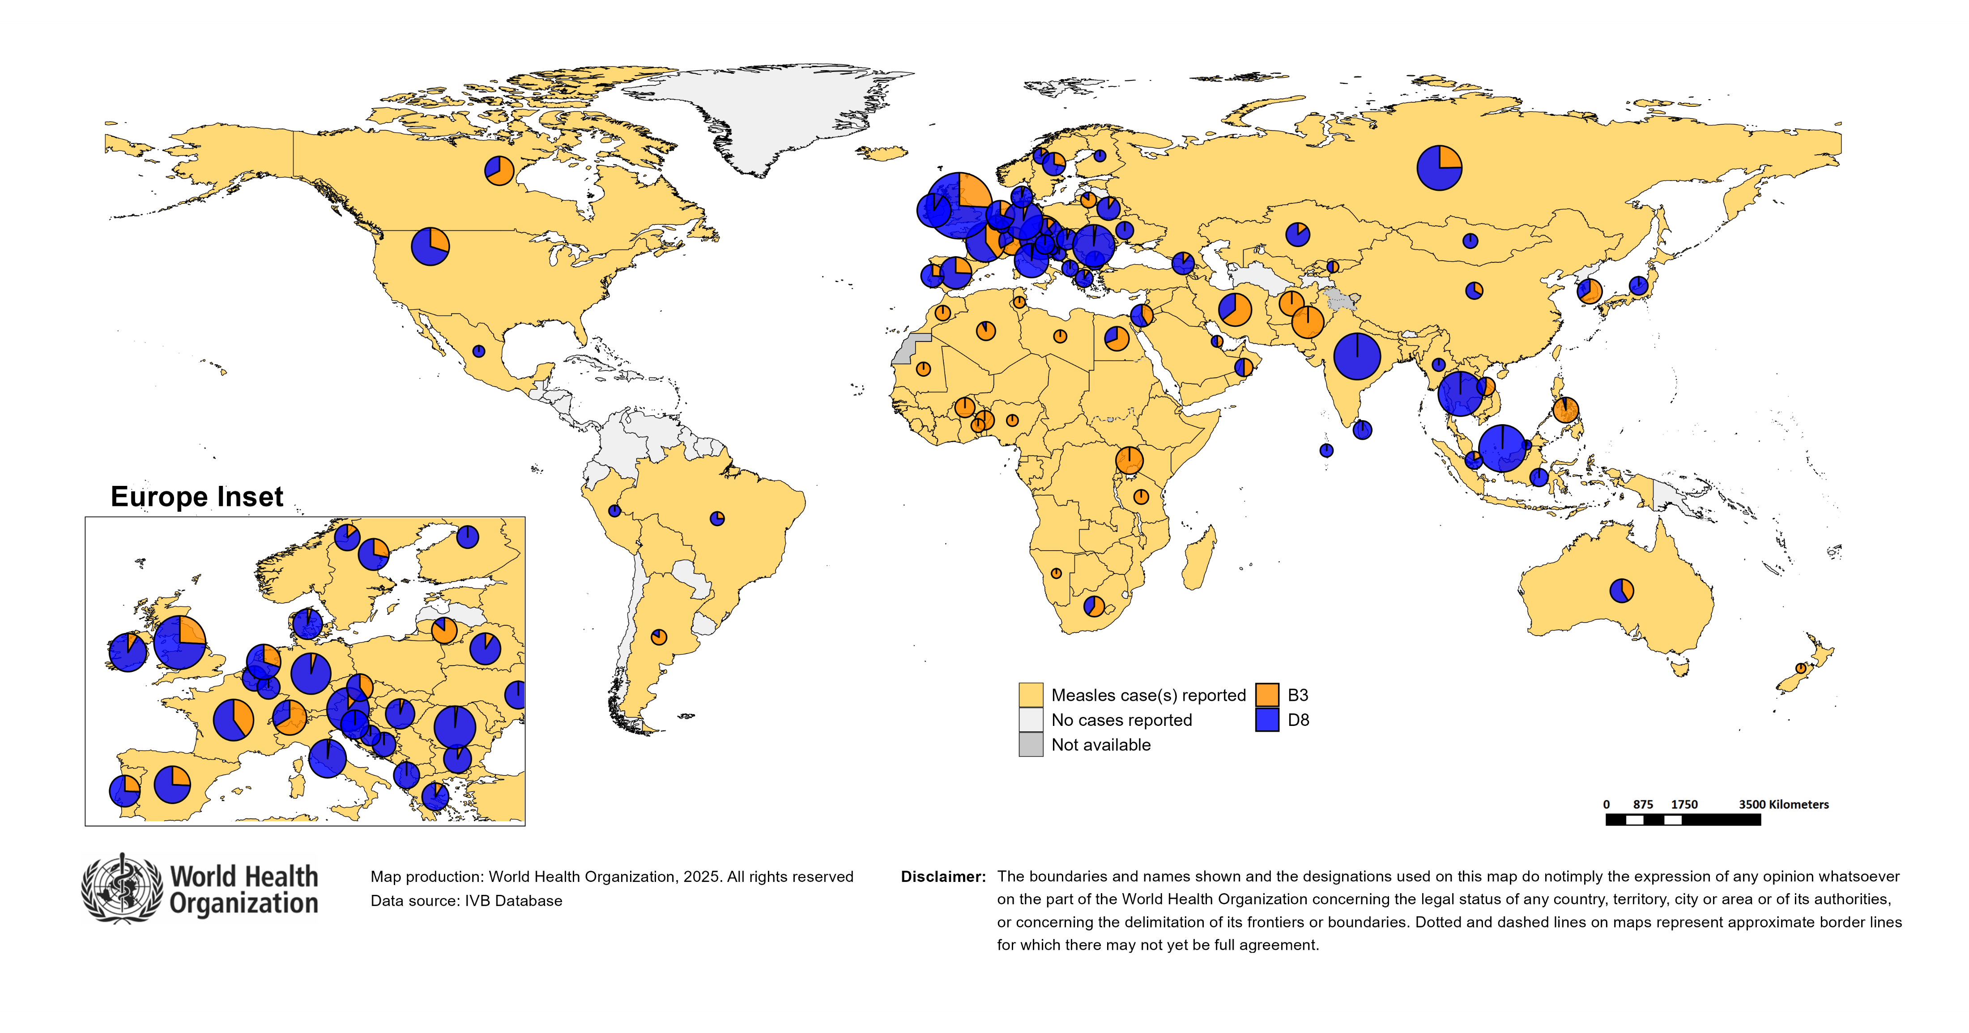
Distribution of measles genotypes (last 12 months)
Data Source: MeaNS2 database (Genotypes) and IVB Database (Incidence) as of 2025-01-13 and covering the period between 2023-12 and 2024-11 - Pie charts proportional to the number of sequenced viruses

Slide 46
Rubella

Slide 47
Number of reported rubella cases by WHO Region
2024
Region | Member States* | Rubella cases | Clin | Epi | Lab | Date Received
AFR | 43/47 | 8,914 | 0 | 0 | 8,914 | 2024-12
AMR | 28/35 | 0 | 0 | 0 | 0 | 2025-01
EMR | 20/21 | 692 | 21 | 6 | 665 | 2025-01
EUR | 33/53 | 481 | 201 | 2 | 278 | 2025-01
SEAR | 11/11 | 2,622 | 0 | 82 | 2,540 | 2024-12
WPR | 16/27 | 737 | 263 | 1 | 473 | 2025-01
Total | 151/194 | 13,446 | 485 | 91 | 12,870
Region | Jan | Feb | Mar | Apr | May | Jun | Jul | Aug | Sep | Oct | Nov | Dec
AFR | 334 | 319 | 629 | 547 | 666 | 498 | 361 | 1,767 | 2,900 | 875 | 18 | 0
AMR | 0 | 0 | 0 | 0 | 0 | 0 | 0 | 0 | 0 | 0 | 0 | 0
EMR | 71 | 95 | 93 | 71 | 89 | 85 | 47 | 53 | 30 | 26 | 24 | 8
EUR | 25 | 38 | 49 | 66 | 78 | 52 | 43 | 50 | 29 | 25 | 24 | 2
SEAR | 281 | 312 | 319 | 272 | 257 | 190 | 256 | 196 | 233 | 243 | 63 | 0
WPR | 49 | 39 | 94 | 84 | 88 | 54 | 63 | 70 | 53 | 88 | 51 | 4
Total | 760 | 803 | 1,184 | 1,040 | 1,178 | 879 | 770 | 2,136 | 3,245 | 1,257 | 180 | 14
2023
Region | Member States* | Rubella cases | Clin | Epi | Lab | Date Received
AFR | 43/47 | 4,294 | 0 | 0 | 4,294 | 2024-12
AMR | 27/35 | 0 | 0 | 0 | 0 | 2025-01
EMR | 21/21 | 1,590 | 77 | 353 | 1,160 | 2025-01
EUR | 31/53 | 334 | 261 | 4 | 69 | 2025-01
SEAR | 11/11 | 3,646 | 0 | 164 | 3,482 | 2024-12
WPR | 16/27 | 820 | 87 | 0 | 733 | 2025-01
Total | 149/194 | 10,684 | 425 | 521 | 9,738
Region | Jan | Feb | Mar | Apr | May | Jun | Jul | Aug | Sep | Oct | Nov | Dec
AFR | 498 | 646 | 767 | 607 | 410 | 311 | 246 | 177 | 188 | 192 | 151 | 101
AMR | 0 | 0 | 0 | 0 | 0 | 0 | 0 | 0 | 0 | 0 | 0 | 0
EMR | 206 | 252 | 204 | 150 | 165 | 164 | 110 | 65 | 75 | 73 | 68 | 58
EUR | 25 | 19 | 29 | 36 | 25 | 34 | 29 | 30 | 26 | 25 | 23 | 33
SEAR | 426 | 348 | 375 | 360 | 349 | 235 | 203 | 256 | 256 | 249 | 313 | 276
WPR | 26 | 43 | 83 | 78 | 89 | 79 | 82 | 72 | 58 | 81 | 77 | 52
Total | 1,181 | 1,308 | 1,458 | 1,231 | 1,038 | 823 | 670 | 600 | 603 | 620 | 632 | 520
Notes: Based on data received 2025-01 - This is surveillance data, hence for the last month, the data may be incomplete. * Member States Reporting / Total Member States in Region

Slide 48
Rubella case distribution by month and WHO Region (2016-2024)
12,000
2016
2017
2018
2019
2020
2021
2022
2023
2024
Total = 18,679 cases
Total = 10,712 cases
Total = 17,045 cases
Total = 47,766 cases
Total = 7,501 cases
Total = 7,410 cases
Total = 12,620 cases
Total = 10,684 cases
Total = 13,446 cases
9,000
AFR
AMR
6,000
EMR
EUR
SEAR
WPR
3,000
0
May
Sep
Sep
Sep
Sep
Sep
Sep
Sep
Sep
Sep
Apr
Aug
May
Aug
May
Aug
May
Aug
May
Aug
May
Aug
May
Aug
May
Aug
May
Aug
Jan
Jun
Jul
Oct
Jan
Apr
Jun
Jul
Oct
Jan
Apr
Jun
Jul
Oct
Jan
Apr
Jun
Jul
Oct
Jan
Apr
Jun
Jul
Oct
Jan
Apr
Jun
Jul
Oct
Jan
Apr
Jun
Jul
Oct
Jan
Apr
Jun
Jul
Oct
Jan
Apr
Jun
Jul
Oct
Feb
Mar
Nov
Dec
Feb
Mar
Nov
Dec
Feb
Mar
Nov
Dec
Feb
Mar
Nov
Dec
Feb
Mar
Nov
Dec
Feb
Mar
Nov
Dec
Feb
Mar
Nov
Dec
Feb
Mar
Nov
Dec
Feb
Mar
Nov
Dec
Notes: Based on data received 2025-01 - Data Source: IVB Database - This is surveillance data, hence for the last month(s), the data may be incomplete.

Slide 49
Rubella case distribution by month and WHO Region (2022-2024)
2022
2023
2024
Total = 12,620 cases
Total = 10,684 cases
Total = 13,446 cases
3,000
AFR
2,000
EMR
EUR
SEAR
WPR
1,000
0
Jan
Feb
Mar
Apr
May
Jun
Jul
Aug
Sep
Oct
Nov
Dec
Jan
Feb
Mar
Apr
May
Jun
Jul
Aug
Sep
Oct
Nov
Dec
Jan
Feb
Mar
Apr
May
Jun
Jul
Aug
Sep
Oct
Nov
Dec
Notes: Based on data received 2025-01 - Data Source: IVB Database - This is surveillance data, hence for the last month(s), the data may be incomplete.

Slide 50
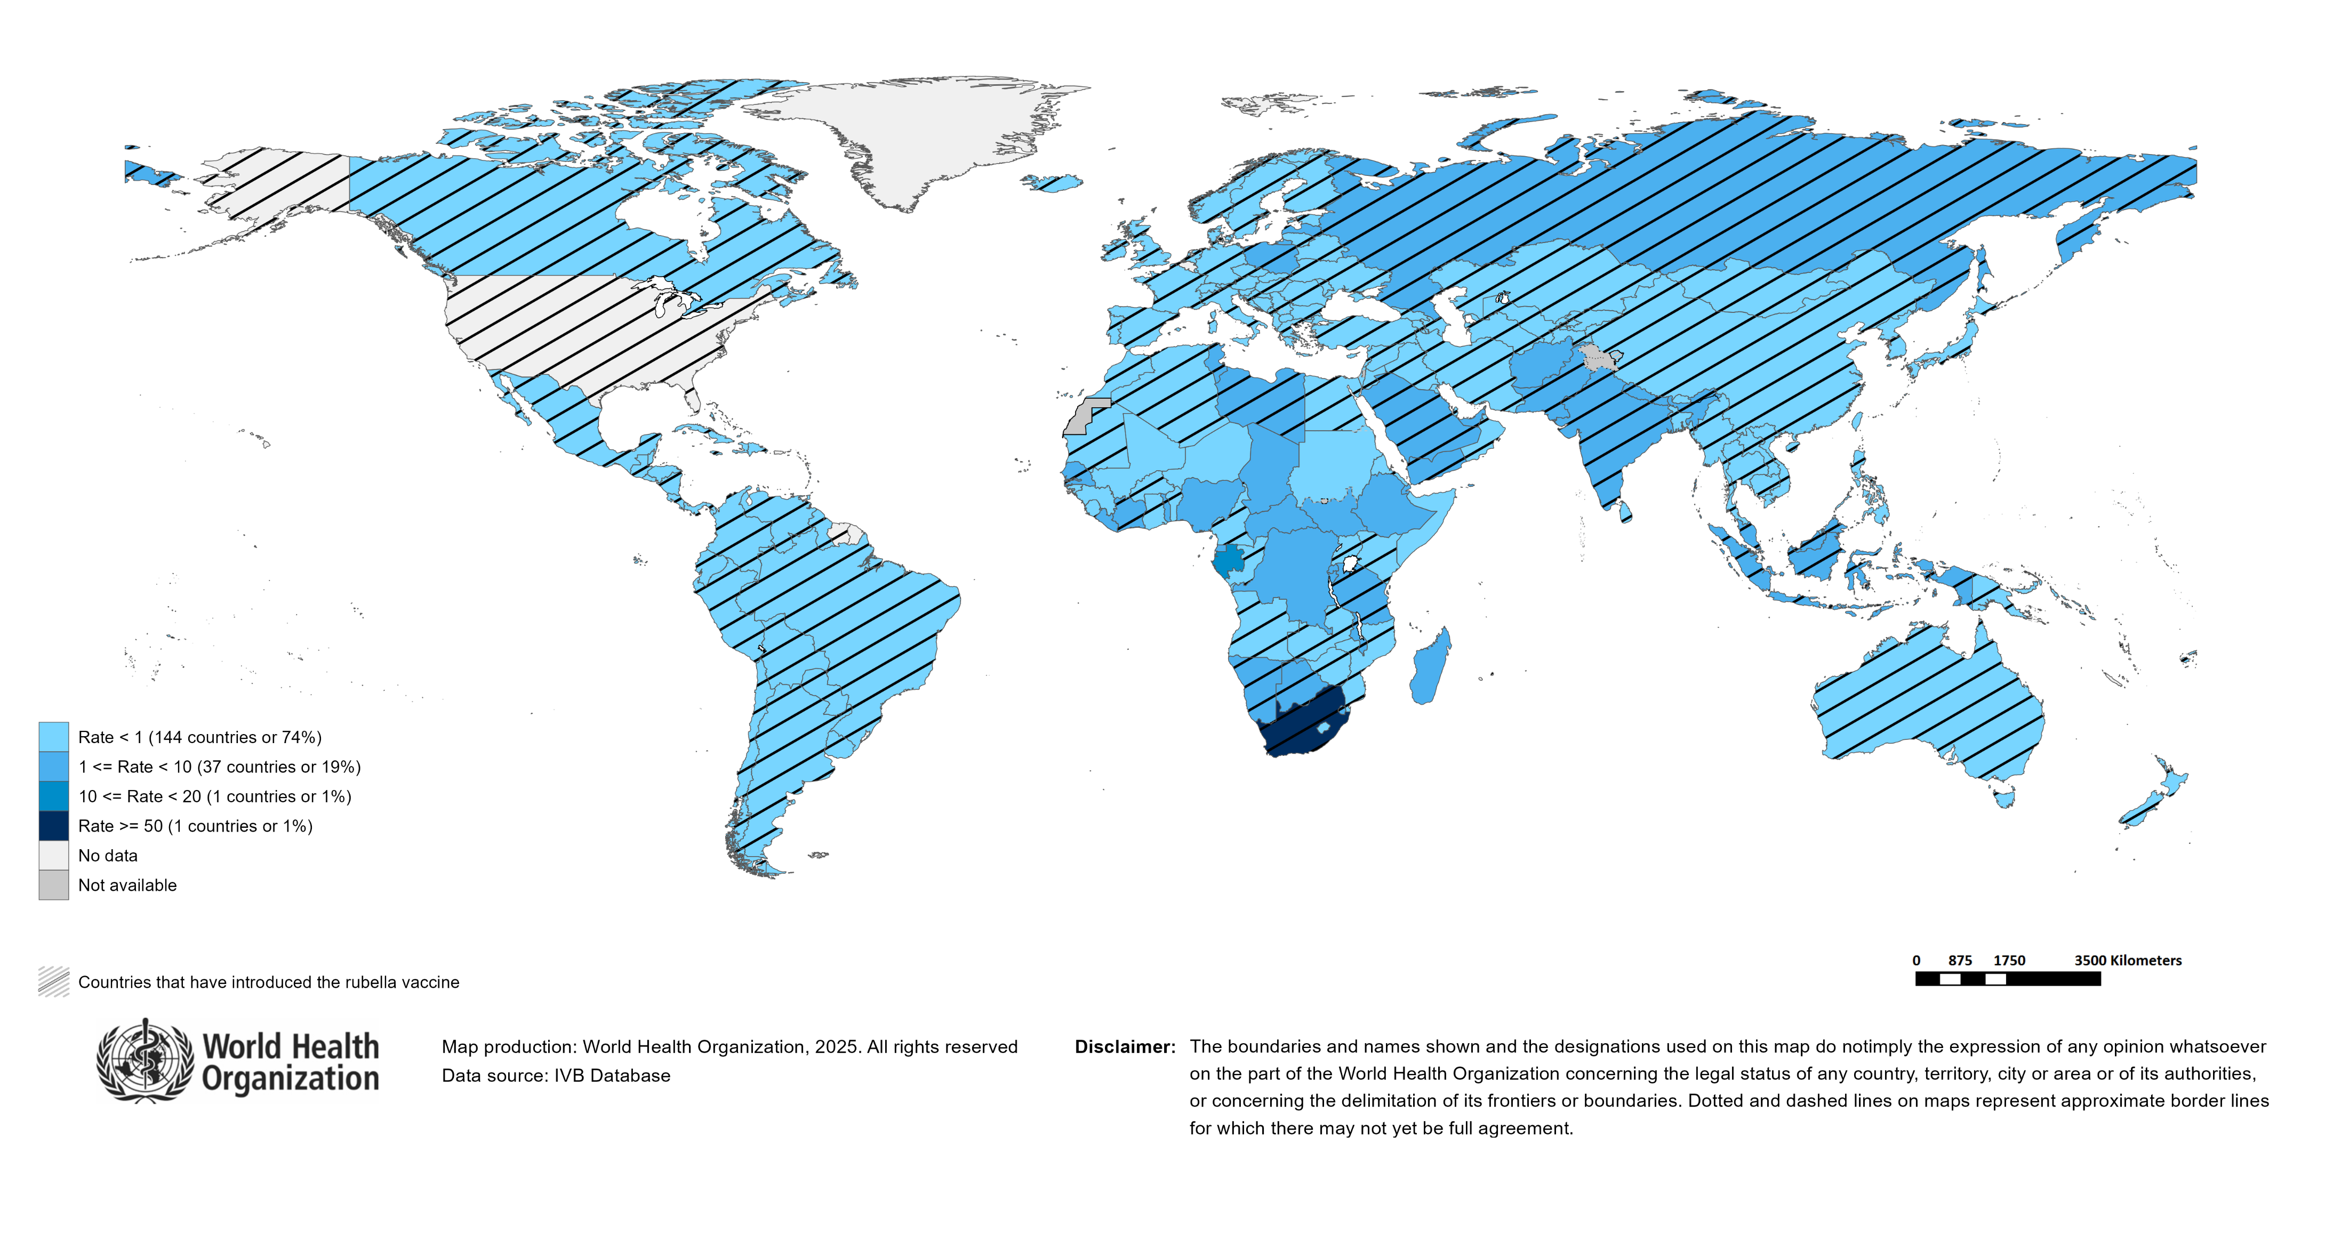
Rubella Incidence Rate per Million (12M period)
Highest incidence rates | Highest incidence rates | Highest incidence rates
Country | Cases | Rate
South Africa | 7107 | 111.03
Gabon | 47 | 18.51
Libya | 50 | 6.77
Poland | 209 | 5.42
Chad | 97 | 4.78
Togo | 42 | 4.41
Liberia | 23 | 4.10
Afghanistan | 153 | 3.59
Madagascar | 105 | 3.28
United Republic of Tanzania | 220 | 3.21
Notes: Based on data received 2025-01 - Surveillance data from 2024-06 to 2024-11 - Incidence: Number of cases / population * 1,000,000 - Population data: World population prospects, 2019 revision

Slide 51
Disclaimer
This document contains data provided to WHO by member states. Note that some member states only provide aggregate data to WHO, and for these, we are unable to generate a country profile. Some member states report all cases at one time point for the entire year, and thus epidemiologic curves generated are not accurate and a reporting artifact. For some countries, cases are reported by age category, not by exact age in months and/or years. Thus, age distribution/incidence is approximate. Cases classified as pending by countries are classified at WHO as clinically compatible at this time, and thus numbers might different between data shown here and provided by the member state or WHO country/regional offices.
*UN population data is used as the denominator for calculating incidence.

Slide 52
Rubella cases (AFR)
AFR Rubella Case Distribution (January 2023-January 2025)
Top 10 countries (last 12 M) | Top 10 countries (last 12 M) | Top 10 countries (last 12 M) | Top 10 countries (last 12 M)
Country | RCV in RI | Cases | % of Total
South Africa | No | 7107 | 80
Nigeria | No | 582 | 7
Others | - | 256 | 3
United Republic of Tanzania | 2014 | 219 | 2
DR Congo | No | 211 | 2
Ethiopia | No | 179 | 2
Madagascar | No | 97 | 1
Chad | No | 96 | 1
Côte d'Ivoire | 2018 | 80 | 1
Gabon | No | 45 | 1
Togo | 2018 | 42 | 0
3,000
2023
2024
2,000
(lab + epi-linked + clinical)
Number of cases
1,000
0
Jan
Feb
Mar
Apr
May
Jun
Jul
Aug
Sep
Oct
Nov
Dec
Jan
Feb
Mar
Apr
May
Jun
Jul
Aug
Sep
Oct
Nov
Dec
Introduced less than 5 years ago
Introduced more than 5 years ago
Not introduced in EPI
(after 2020)
(2020 and before)
AFR Age distribution of Rubella IgM+ cases by vaccine introduction status in the National EPI Programme (last 12 Months)
1000
750
500
(IgM+ only)
Number of cases
250
0
0
10
20
30
40
Age at onset (in years)
Rubella vaccine introduced before 1 January 2025
Rubella vaccine not introduced before 1 January 2025
Notes: Based on data received 2025-01 Data Source: IVB Database.

Slide 53
Rubella cases: Nigeria
ELIMINATION STATUS:
ENDEMIC
2022
2023
2024
2025
300
Total = 895 cases
Total = 740 cases
Total = 582 cases
200
Rubella cases
100
0
Jan
Feb
Mar
Apr
May
Jun
Jul
Aug
Sep
Oct
Nov
Dec
Jan
Feb
Mar
Apr
May
Jun
Jul
Aug
Sep
Oct
Nov
Dec
Jan
Feb
Mar
Apr
May
Jun
Jul
Aug
Sep
Oct
Nov
Dec
Jan
Feb
Mar
Apr
May
Jun
Jul
Aug
Sep
Oct
Nov
Dec
Clinical
Epi
Lab
Age distribution, sex and incidence (Last 12 months)
WHO/UNICEF Coverage Estimates (WUENIC)
100
150
6
80
100
4
Number of cases
Incidence rate per M
60
50
2
% Coverage
40
0
0
20
<1 yr
1-4 yrs
5-9 yrs
10-14 yrs
15-24 yrs
25-39 yrs
40+ yrs
0
Age at onset (in years)
2000
2001
2002
2003
2004
2005
2006
2007
2008
2009
2010
2011
2012
2013
2014
2015
2016
2017
2018
2019
2020
2021
2022
2023
Incidence
Male
Female
Unknown
RCV1

Slide 54
Rubella cases (EMR)
EMR Rubella Case Distribution (January 2023-January 2025)
Top 10 countries (last 12 M) | Top 10 countries (last 12 M) | Top 10 countries (last 12 M) | Top 10 countries (last 12 M)
Country | RCV in RI | Cases | % of Total
Pakistan | 2022 | 311 | 45
Afghanistan | No | 151 | 22
Saudi Arabia | 1982 | 55 | 8
Libya | 1993 | 38 | 5
Yemen | 2015 | 38 | 5
Sudan | No | 24 | 3
Others | - | 19 | 3
Tunisia | 2012 | 18 | 3
United Arab Emirates | 1985 | 18 | 3
Syrian Arab Republic | 1999 | 13 | 2
Morocco | 2003 | 7 | 1
2023
2024
250
200
150
(lab + epi-linked + clinical)
Number of cases
100
50
0
Jan
Feb
Mar
Apr
May
Jun
Jul
Aug
Sep
Oct
Nov
Dec
Jan
Feb
Mar
Apr
May
Jun
Jul
Aug
Sep
Oct
Nov
Dec
Introduced less than 5 years ago
Introduced more than 5 years ago
Not introduced in EPI
(after 2020)
(2020 and before)
EMR Age distribution of Rubella IgM+ cases by vaccine introduction status in the National EPI Programme (last 12 Months)
150
100
(IgM+ only)
Number of cases
50
0
0
10
20
30
40
Age at onset (in years)
Rubella vaccine introduced before 1 January 2025
Rubella vaccine not introduced before 1 January 2025
Notes: Based on data received 2025-01 Data Source: IVB Database.

Slide 55
Rubella cases: Afghanistan
ELIMINATION STATUS:
ENDEMIC
2022
2023
2024
2025
50
Total = 197 cases
Total = 229 cases
Total = 151 cases
40
30
Rubella cases
20
10
0
Jan
Feb
Mar
Apr
May
Jun
Jul
Aug
Sep
Oct
Nov
Dec
Jan
Feb
Mar
Apr
May
Jun
Jul
Aug
Sep
Oct
Nov
Dec
Jan
Feb
Mar
Apr
May
Jun
Jul
Aug
Sep
Oct
Nov
Dec
Jan
Feb
Mar
Apr
May
Jun
Jul
Aug
Sep
Oct
Nov
Dec
Clinical
Epi
Lab
Age distribution, sex and incidence (Last 12 months)
WHO/UNICEF Coverage Estimates (WUENIC)
15
100
40
80
10
Number of cases
Incidence rate per M
60
20
5
% Coverage
40
0
0
20
<1 yr
1-4 yrs
5-9 yrs
10-14 yrs
15-24 yrs
25-39 yrs
40+ yrs
0
Age at onset (in years)
2000
2001
2002
2003
2004
2005
2006
2007
2008
2009
2010
2011
2012
2013
2014
2015
2016
2017
2018
2019
2020
2021
2022
2023
Incidence
Male
Female
Unknown
RCV1

Slide 56
Rubella cases (EUR)
EUR Rubella Case Distribution (January 2023-January 2025)
Top 10 countries (last 12 M) | Top 10 countries (last 12 M) | Top 10 countries (last 12 M) | Top 10 countries (last 12 M)
Country | RCV in RI | Cases | % of Total
Russian Federation | 2000 | 224 | 47
Poland | 1988 | 182 | 38
Germany | 1991 | 26 | 5
Türkiye | 2006 | 17 | 4
Kazakhstan | 2004 | 10 | 2
Ukraine | 2003 | 10 | 2
Others | - | 4 | 1
Israel | 1995 | 3 | 1
Italy | 1972 | 2 | 0
Latvia | 1993 | 2 | 0
Bulgaria | 1992 | 1 | 0
2023
2024
80
60
(lab + epi-linked + clinical)
Number of cases
40
20
0
Jan
Feb
Mar
Apr
May
Jun
Jul
Aug
Sep
Oct
Nov
Dec
Jan
Feb
Mar
Apr
May
Jun
Jul
Aug
Sep
Oct
Nov
Dec
Introduced more than 5 years ago
(2020 and before)
EUR Age distribution of Rubella IgM+ cases by vaccine introduction status in the National EPI Programme (last 12 Months)
15
10
(IgM+ only)
Number of cases
5
0
0
10
20
30
40
Age at onset (in years)
Rubella vaccine introduced before 1 January 2025
Rubella vaccine not introduced before 1 January 2025
Notes: Based on data received 2025-01 Data Source: IVB Database. Spikes in age-distribution curve are an artifact of reporting by age bands ( 0=<1 yrs, 2=1-4 yrs, 7=5-9 yrs, 12=10-14 yrs, 17=15-19 yrs, 25=20-29 yrs, 45=30+yrs) instead of by age from some member states.

Slide 57
Rubella cases (SEAR (excl. India))
SEAR (excl. India) Rubella Case Distribution (January 2023-January 2025)
Top 10 countries (last 12 M) | Top 10 countries (last 12 M) | Top 10 countries (last 12 M) | Top 10 countries (last 12 M)
Country | RCV in RI | Cases | % of Total
Indonesia | 2018 | 297 | 65
Bangladesh | 2012 | 84 | 18
Nepal | 2013 | 43 | 9
Thailand | 1997 | 24 | 5
Myanmar | 2015 | 7 | 2
Timor-Leste | 2016 | 4 | 1
2023
2024
125
100
75
(lab + epi-linked + clinical)
Number of cases
50
25
0
Jan
Feb
Mar
Apr
May
Jun
Jul
Aug
Sep
Oct
Nov
Dec
Jan
Feb
Mar
Apr
May
Jun
Jul
Aug
Sep
Oct
Nov
Dec
Introduced more than 5 years ago
(2020 and before)
SEAR (excl. India) Age distribution of Rubella IgM+ cases by vaccine introduction status in the National EPI Programme (last 12 Months)
75
50
(IgM+ only)
Number of cases
25
0
0
10
20
30
40
Age at onset (in years)
Rubella vaccine introduced before 1 January 2025
Rubella vaccine not introduced before 1 January 2025
Notes: Based on data received 2025-01 Data Source: IVB Database.

Slide 58
Rubella cases (SEAR, India)
SEAR, India Rubella Case Distribution (January 2023-January 2025)
Top 10 countries (last 12 M) | Top 10 countries (last 12 M) | Top 10 countries (last 12 M) | Top 10 countries (last 12 M)
Country | RCV in RI | Cases | % of Total
India | 2018 | 2163 | 100
2023
2024
300
200
(lab + epi-linked + clinical)
Number of cases
100
0
Jan
Feb
Mar
Apr
May
Jun
Jul
Aug
Sep
Oct
Nov
Dec
Jan
Feb
Mar
Apr
May
Jun
Jul
Aug
Sep
Oct
Nov
Dec
Introduced more than 5 years ago
(2020 and before)
SEAR, India Age distribution of Rubella IgM+ cases by vaccine introduction status in the National EPI Programme (last 12 Months)
600
400
(IgM+ only)
Number of cases
200
0
0
10
20
30
40
Age at onset (in years)
Rubella vaccine introduced before 1 January 2025
Rubella vaccine not introduced before 1 January 2025
Notes: Based on data received 2025-01 Data Source: IVB Database.

Slide 59
Rubella cases: India
ELIMINATION STATUS:
ENDEMIC
2022
2023
2024
2025
500
Total = 2,559 cases
Total = 2,930 cases
Total = 2,163 cases
400
300
Rubella cases
200
100
0
Jan
Feb
Mar
Apr
May
Jun
Jul
Aug
Sep
Oct
Nov
Dec
Jan
Feb
Mar
Apr
May
Jun
Jul
Aug
Sep
Oct
Nov
Dec
Jan
Feb
Mar
Apr
May
Jun
Jul
Aug
Sep
Oct
Nov
Dec
Jan
Feb
Mar
Apr
May
Jun
Jul
Aug
Sep
Oct
Nov
Dec
Clinical
Epi
Lab
Age distribution, sex and incidence (Last 12 months)
WHO/UNICEF Coverage Estimates (WUENIC)
30
100
750
80
500
20
Number of cases
Incidence rate per M
60
250
10
% Coverage
40
0
0
20
<1 yr
1-4 yrs
5-9 yrs
10-14 yrs
15-24 yrs
25-39 yrs
40+ yrs
0
Age at onset (in years)
2000
2001
2002
2003
2004
2005
2006
2007
2008
2009
2010
2011
2012
2013
2014
2015
2016
2017
2018
2019
2020
2021
2022
2023
Incidence
Male
Female
Unknown
RCV1

Slide 60
Rubella cases (WPR)
WPR Rubella Case Distribution (January 2023-January 2025)
Top 10 countries (last 12 M) | Top 10 countries (last 12 M) | Top 10 countries (last 12 M) | Top 10 countries (last 12 M)
Country | RCV in RI | Cases | % of Total
China | 2008 | 538 | 73
Malaysia | 2004 | 85 | 12
Philippines | 2010 | 54 | 7
Viet Nam | 2015 | 41 | 6
Cambodia | 2013 | 11 | 1
Japan | 1995 | 6 | 1
Lao People's Democratic Republic | 2012 | 1 | 0
Singapore | 1982 | 1 | 0
2023
2024
75
50
(lab + epi-linked + clinical)
Number of cases
25
0
Jan
Feb
Mar
Apr
May
Jun
Jul
Aug
Sep
Oct
Nov
Dec
Jan
Feb
Mar
Apr
May
Jun
Jul
Aug
Sep
Oct
Nov
Dec
Introduced more than 5 years ago
(2020 and before)
WPR Age distribution of Rubella IgM+ cases by vaccine introduction status in the National EPI Programme (last 12 Months)
100
75
50
(IgM+ only)
Number of cases
25
0
0
10
20
30
40
Age at onset (in years)
Rubella vaccine introduced before 1 January 2025
Rubella vaccine not introduced before 1 January 2025
Notes: Based on data received 2025-01 Data Source: IVB Database.

Slide 61
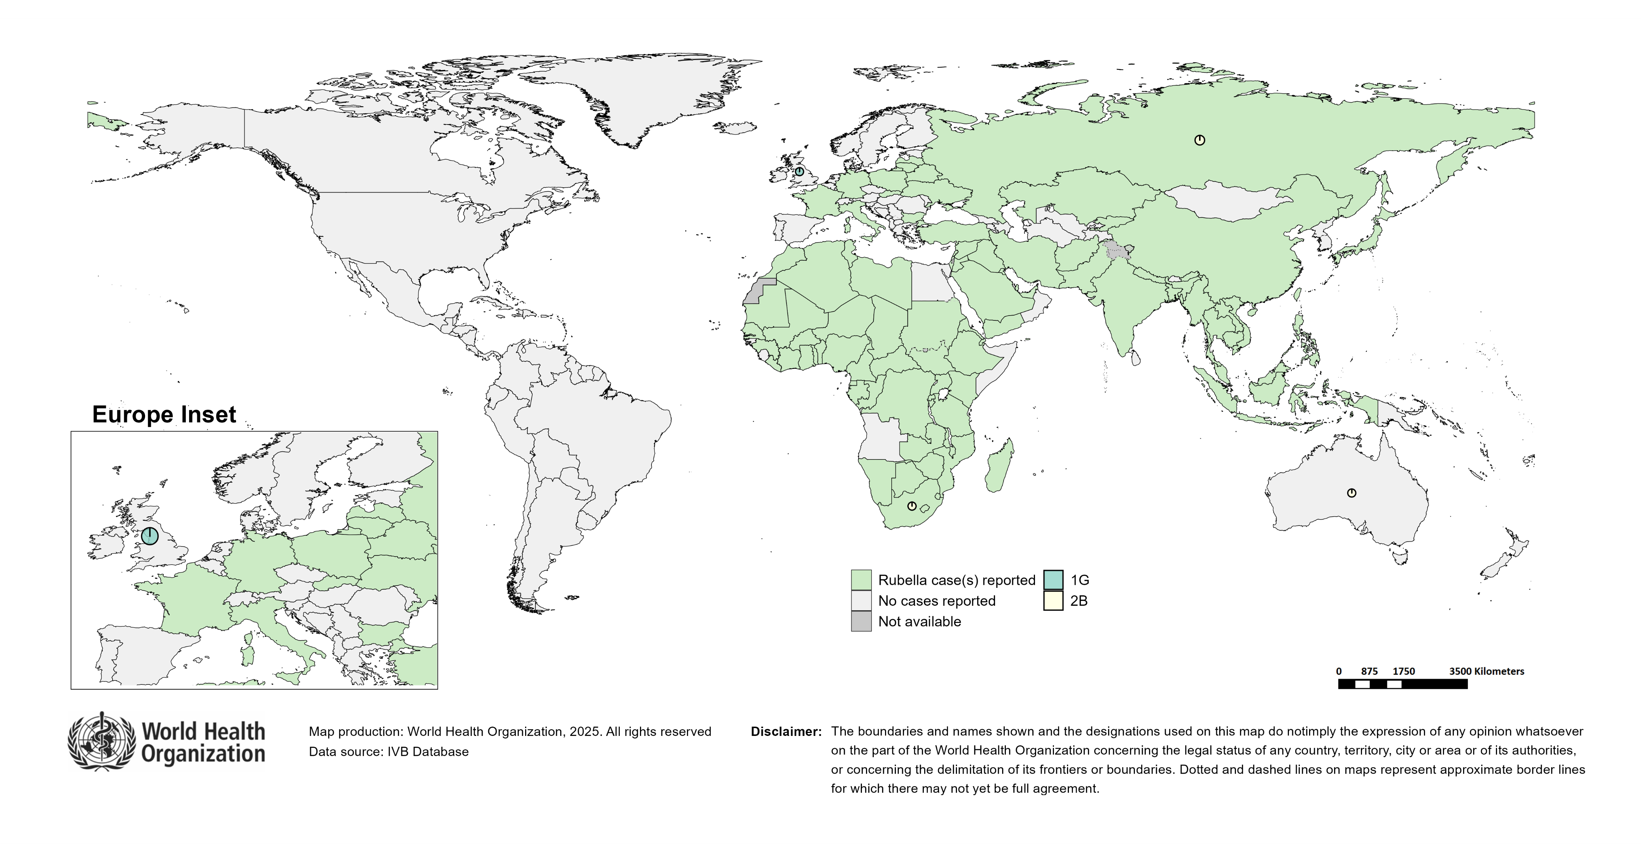
Distribution of rubella genotypes (last 12 months)
Data Source: RUBENS2 database (Genotypes) and IVB Database (Incidence) as of 2025-01-13 and covering the period between 2023-12 and 2024-11 - Pie charts proportional to the number of sequenced viruses

Slide 62
Laboratory

Slide 63
Measles and Rubella IgM Data Summary
2024
Region | Member States* | Specimens received | Measles tested | Measles positive n(%) | Measles equivocal n(%) | Measles negative n(%) | Rubella tested | Rubella positive n(%) | Rubella equivocal n(%) | Rubella negative n(%)
AFR | 43/47 | 80,065 | 57,843 | 18,554 (32) | 1,023 (2) | 38,264 (66) | 43,873 | 2,596 (6) | 405 (1) | 40,868 (93)
AMR | 29/35 | 9,014 | 9,079 | 349 (4) | 213 (2) | 8,517 (94) | 8,617 | 165 (2) | 90 (1) | 8,362 (97)
EMR | 20/21 | 97,809 | 82,269 | 33,056 (40) | 120 (0) | 49,093 (60) | 73,885 | 1,114 (2) | 68 (0) | 72,703 (98)
EUR | 39/53 | 151,828 | 131,187 | 76,376 (58) | 359 (0) | 49,417 (38) | 52,424 | 1,149 (2) | 99 (0) | 50,883 (97)
SEAR | 11/11 | 119,174 | 117,326 | 17,174 (15) | 3,333 (3) | 100,130 (85) | 108,171 | 2,742 (3) | 2,752 (3) | 104,727 (97)
WPR | 25/27 | 21,655 | 20,293 | 5,156 (25) | 474 (2) | 14,639 (72) | 15,647 | 551 (4) | 84 (1) | 14,983 (96)
Total | 167/194 | 479,545 | 417,997 | 150,665 (36) | 5,522 (1) | 260,060 (62) | 302,617 | 8,317 (3) | 3,498 (1) | 292,526 (97)
2023
Region | Member States* | Specimens received | Measles tested | Measles positive n(%) | Measles equivocal n(%) | Measles negative n(%) | Rubella tested | Rubella positive n(%) | Rubella equivocal n(%) | Rubella negative n(%)
AFR | 45/47 | 69,074 | 66,896 | 19,940 (30) | 1,341 (2) | 45,467 (68) | 51,542 | 5,521 (11) | 943 (2) | 44,837 (87)
AMR | 25/35 | 8,290 | 8,009 | 191 (2) | 154 (2) | 7,664 (96) | 7,554 | 126 (2) | 80 (1) | 7,348 (97)
EMR | 21/21 | 113,644 | 79,248 | 29,696 (37) | 194 (0) | 49,358 (62) | 75,076 | 1,904 (3) | 207 (0) | 72,965 (97)
EUR | 39/53 | 78,862 | 71,369 | 37,560 (53) | 272 (0) | 26,813 (38) | 48,344 | 726 (2) | 100 (0) | 44,915 (93)
SEAR | 10/11 | 150,949 | 141,944 | 47,566 (34) | 5,781 (4) | 96,236 (68) | 102,351 | 6,889 (7) | 4,392 (4) | 98,672 (96)
WPR | 25/27 | 17,213 | 16,004 | 2,882 (18) | 278 (2) | 12,834 (80) | 13,572 | 687 (5) | 92 (1) | 12,789 (94)
Total | 165/194 | 438,032 | 383,470 | 137,835 (36) | 8,020 (2) | 238,372 (62) | 298,439 | 15,853 (5) | 5,814 (2) | 281,526 (94)
Notes: Based on data received 2025-01 - * Member States Reporting / Total Member States in Region

Slide 64
Supplementary Immunization Activities

Slide 65
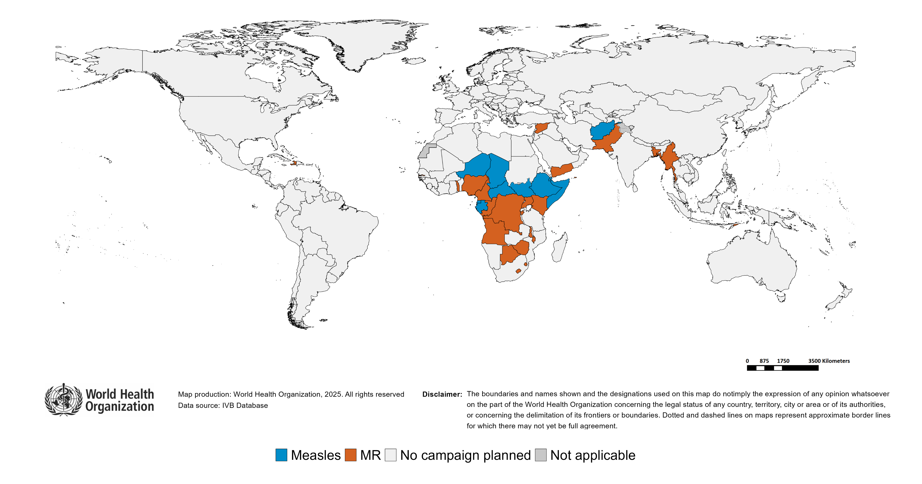
Upcoming MMR, MR and Measles campaigns (2025-2026)

Slide 66
Upcoming MMR, MR and Measles campaigns (2025-2026)
Year | Region | Name | Type | Intervention | StartDate | Status | Age Group(s) | Extent | Target
2025 | AFR | Congo | FollowUp | MR | 2025-08-?? | Planned | 9-59 M | NATIONAL | 846894
2025 | AFR | Democratic Republic of the Congo | CatchUp | MR | 2025-10-?? | Planned | 9 M-14 Y | NATIONAL | 61697195
2025 | AFR | Central African Republic | FollowUp | MEASLES | 2025-11-?? | Planned | 9-59 M | NATIONAL | 984810
2025 | AFR | Lesotho | CatchUp-SIA | MR | 2025-11-?? | Planned | 9-59 M | NATIONAL | 274805
2025 | AFR | Uganda | FollowUp | MR | 2025-11-?? | Planned | 9-59 M | NATIONAL | 7685529
2025 | AFR | Comoros | FollowUp | MR | 2025-12-?? | Planned | 9-59 M | NATIONAL | 113688
2025 | AFR | Togo | FollowUp | MR | 2025-12-?? | Planned | 9-59 M | NATIONAL | 2219710
2025 | AFR | Botswana | FollowUp | MR | 2025-NA-?? | Planned | 9-59 M | NATIONAL | 148268
2025 | AFR | Chad | FollowUp | MEASLES | 2025-NA-?? | Planned | 9-59 M | NATIONAL | 3217682
2025 | AFR | Chad | Follow-Up | MEASLES | 2025-NA-?? | Planned | 9-59 M | NATIONAL | 4972177
2025 | AFR | Eswatini | FollowUp | MR | 2025-NA-?? | Planned | 9-59 M | NATIONAL | 140066
2025 | AFR | Ethiopia | FollowUp | MEASLES | 2025-NA-?? | Planned | 9-59 M | NATIONAL | 17797907
2025 | AFR | Gambia | FollowUp | MR | 2025-NA-?? | Planned | 9-59 M | NATIONAL | 412351
2025 | AFR | Kenya | FollowUp | MR | 2025-NA-?? | Planned | 9-59 M | NATIONAL | 6913106
2025 | AFR | Niger | FollowUp | MEASLES | 2025-NA-?? | Planned | 9-59 M | NATIONAL | 4972177
2025 | AFR | Nigeria | CatchUp | MR | 2025-NA-?? | Planned | 9 M-14 Y | NATIONAL | 97224670
2025 | AFR | South Sudan | FollowUp | MEASLES | 2025-NA-?? | Planned | 9-59 M | NATIONAL | 1485839
2025 | AFR | Zimbabwe | FollowUp | MR | 2025-NA-?? | Planned | 9-59 M | NATIONAL | 2299711
2025 | AMR | Haiti | Campaign | MR | 2025-11-?? | Planned | - | - | -
2025 | EMR | Pakistan | FollowUp | MR | 2025-10-?? | Planned | 9-59 M | NATIONAL | 29604478
2025 | EMR | Afghanistan | FollowUp | MEASLES | 2025-11-?? | Planned | 9-59 M | NATIONAL | 16047992
2025 | EMR | Somalia | FollowUp | MEASLES | 2025-NA-?? | Planned | 9-59 M | NATIONAL | 3200130
2025 | SEAR | Bangladesh | FollowUp | MR | 2025-09-?? | Planned | 9-59 M | NATIONAL | 14663335
2026 | AFR | Angola | FollowUp | MR | 2026-NA-?? | Planned | 9-59 M | NATIONAL | 5983408
2026 | AFR | Burundi | FollowUp | MR | 2026-NA-?? | Planned | 9-59 M | NATIONAL | 2053824
2026 | AFR | Cameroon | FollowUp | MR | 2026-NA-?? | Planned | 9-59 M | NATIONAL | 4345819
2026 | AFR | Equatorial Guinea | FollowUp | MEASLES | 2026-NA-?? | Planned | 9-59 M | NATIONAL | 229691
2026 | AFR | Gabon | FollowUp | MEASLES | 2026-NA-?? | Planned | 9-59 M | - | 306528
2026 | AFR | Malawi | FollowUp | MR | 2026-NA-?? | Planned | 9-59 M | NATIONAL | 3034104
2026 | EMR | Djibouti | CatchUp | MEASLES | 2026-NA-?? | Planned | 9-59 M | NATIONAL | 340185
2026 | EMR | Syrian Arab Republic | FollowUp | MR | 2026-NA-?? | Planned | 9-59 M | NATIONAL | 1892447
2026 | EMR | Yemen | FollowUp | MR | 2026-NA-?? | Planned | 9-59 M | NATIONAL | 4714060
2026 | SEAR | Timor-Leste | FollowUp | MR | 2026-NA-?? | Planned | 9-59 M | NATIONAL | 157311
2026 | WPR | Myanmar | FollowUp | MR | 2026-NA-?? | Planned | 9-59 M | NATIONAL | 4491396

Slide 67
WHO Bulletins and Newsletters

